Slide 1
Couchbase: NoSQL & The Bridge Between
Nic Raboy, Developer Advocate at Couchbase

Slide 2

About Me
Nic Raboy
Developer Advocate at Couchbase
@nraboy (Twitter)
Node.js, Android, Java, Ionic Framework, NoSQL, SQL

Slide 3
There are so many databases available, so what do I choose?

Slide 4
NoSQL?
Polyglot persistence is “…using multiple data storage technologies, chosen based upon the way data is being used by individual applications. Why store binary images in relational database, when there are better storage systems?”
Martin Fowler and Pramod Sadalage
Notes:
The shape of our data and our use of that data determines the way that we store and query it. This part is basically a plea for people to choose the right database for the job and to choose Couchbase on its terms: i.e. you need to think outside the confines of your experience and preferred tools and rather think about what you're trying to achieve and which trade-offs you're willing to make in order to achieve it.

Slide 5
Key-Value
email: nic@couchbase.com

Slide 6
Key-Value
email: {
“work”: “nic@couchbase.com”,
“other”: “nic.raboy@couchbase.com”
}

Slide 7

Key-Value
email:

Slide 8
Document
nic@couchbase.com
{
“city”: “San Francisco”,
“glasses”: true,
“team”: “Developer Advocacy”,
“music”: “Pop!”
}
Notes:
Document has some insight into the document. It could be deeper indexing of the document, it could be query.

Slide 9
Document
London
matthew@couchbase.com
laura@couchbase.com
martin@couchbase.com
james@couchbase.com
tom@couchbase.com
david@couchbase.com
Developer Advocacy
nic@couchbase.com
matt@couchbase.com
william@couchbase.com
matthew@couchbase.com
martin@couchbase.com
laurent@couchbase.com

Slide 10
Document
London & Developer Advocacy
matthew@couchbase.com
laura@couchbase.com
james@couchbase.com
martin@couchbase.com
Notes:
Show that you can run an index across the documents and end up with a compound index of people in a city who are also in a particular team.

Slide 11
The Others: Column & Graph
Notes:
Column databases are great for time series. Graph databases are a fancy query engine on top of something else.
Column: sparse column databases. User profile example with 10000 columns only sparsely populated. No reason to populate certain data. Rather than getting document with all attributes, you get certain bits and pieces. Works well for machine generated data.
Graph: Queried based upon nodes and vertices. Given node “Nic” find all friends.

Slide 12
Where Does Couchbase Fit In?

Slide 13
Couchbase provides a complete Data Management solution
Designed and optimized for interactive web applications
High availability cache
Key-value store
Document database
Embedded database
Sync management
Notes:
KEY POINT: COUCHBASE PROVIDES A SET OF MULTI-PURPOSE, CORE CAPABILITIES THAT SUPPORT A BROAD RANGE OF APPLICATIONS AND USE CASES, ALL IN A SINGLE DATA MANAGEMENT PLATFORM.
Couchbase provides a set of technology capabilities to support a broad range of applications and use cases:
High Availability Cache: Couchbase provides an integrated managed object cache, so you can start out using Couchbase as a high availability cache on top of your existing relational database. For example, you can use Couchbase as a session store in front of your relational database, if your relational DB is struggling to keep up with the load required for online interactive applications.
Key-Value Store: Many customers start with Couchbase as a cache and then broaden their usage to other capabilities, like using Couchbase as a Key-Value Store for things like Profile Management.
Document Database: From there, you can grow into using Couchbase as a Document Database, where you can do more with capabilities like indexing and Cross Data Center Replication.
Embedded Database: Couchbase also provides an embedded database called Couchbase Lite. It’s a purpose-built database for the device, so you can build applications that are always available and always work, whether offline or online.
Sync Management: Finally, as part of our solution for mobile applications, we provide Couchbase Sync Gateway, which automatically synchronizes data on the device with Couchbase Server in the cloud so your developer doesn’t have to write code to manage the complex sync process.
Starting with cache and then expanding to other capabilities is often a good way to learn the technology and get comfortable with Couchbase for a wider set of use cases.

Slide 14
Basic Operation
Application has single logical connection to cluster (client object)
Data is automatically sharded resulting in even document data distribution across cluster
Each vbucket replicated 1, 2 or 3 times (“peer-to-peer” replication)
Docs are automatically hashed by the client to a shard
Cluster map provides location of which server a shard is on
Every read/write/update/delete goes to same node for a given key
Strongly consistent data access (“read your own writes”)
A single Couchbase node can achieve 100k’s ops/sec so no need to scale reads
ACTIVE
ACTIVE
ACTIVE
SHARD
5
SHARD
2
SHARD
9
SHARD
4
SHARD
7
SHARD
8
SHARD
1
SHARD
3
SHARD
6
SHARD
SHARD
SHARD
SHARD
SHARD
SHARD
SHARD
SHARD
SHARD
REPLICA
REPLICA
REPLICA
SHARD
4
SHARD
1
SHARD
8
SHARD
6
SHARD
3
SHARD
2
SHARD
7
SHARD
9
SHARD
5
SHARD
SHARD
SHARD
SHARD
SHARD
SHARD
SHARD
SHARD
SHARD
Couchbase Server 1
Couchbase Server 2
Couchbase Server 3

Slide 15
Relational to NoSQL Document

Slide 16
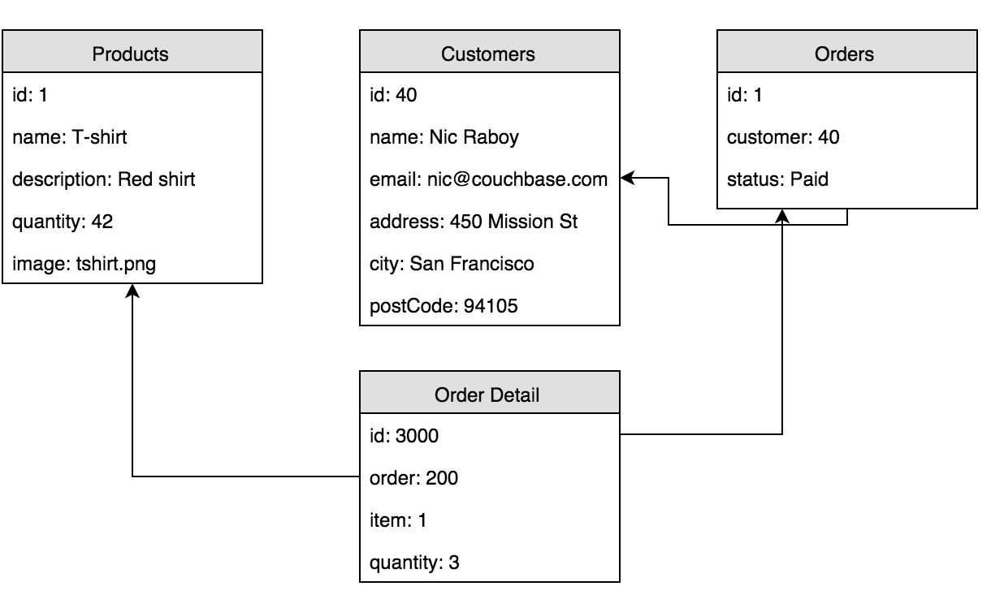
An Ecommerce Order - RDBMS

Slide 17
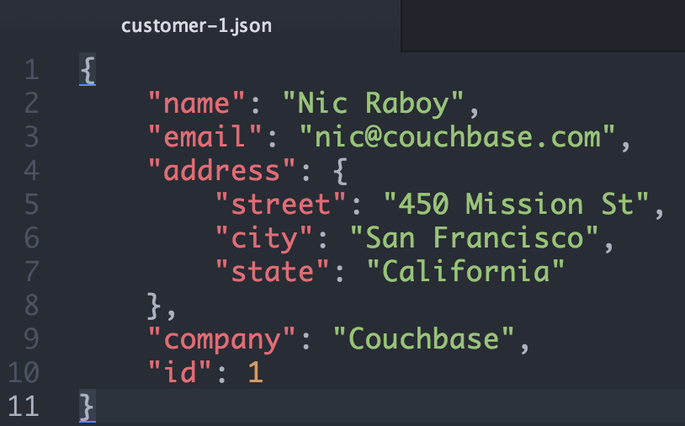
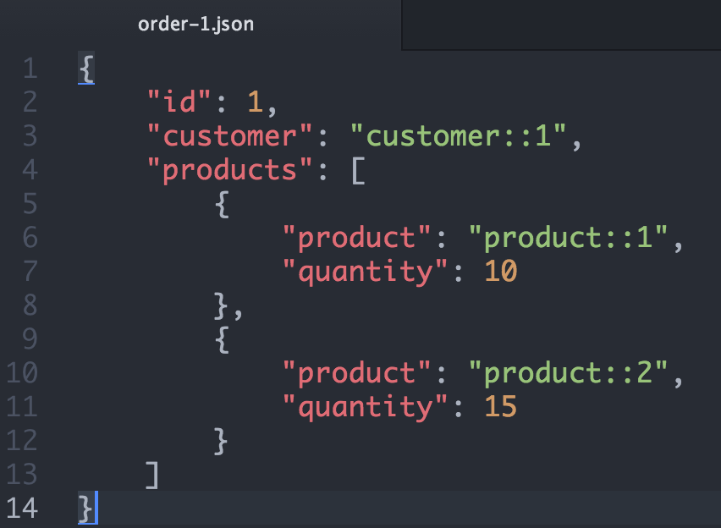
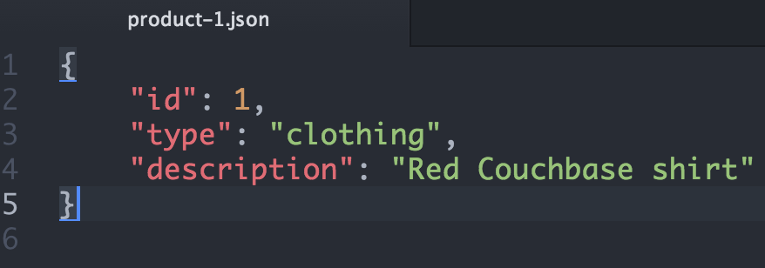
Referred Documents

Slide 18
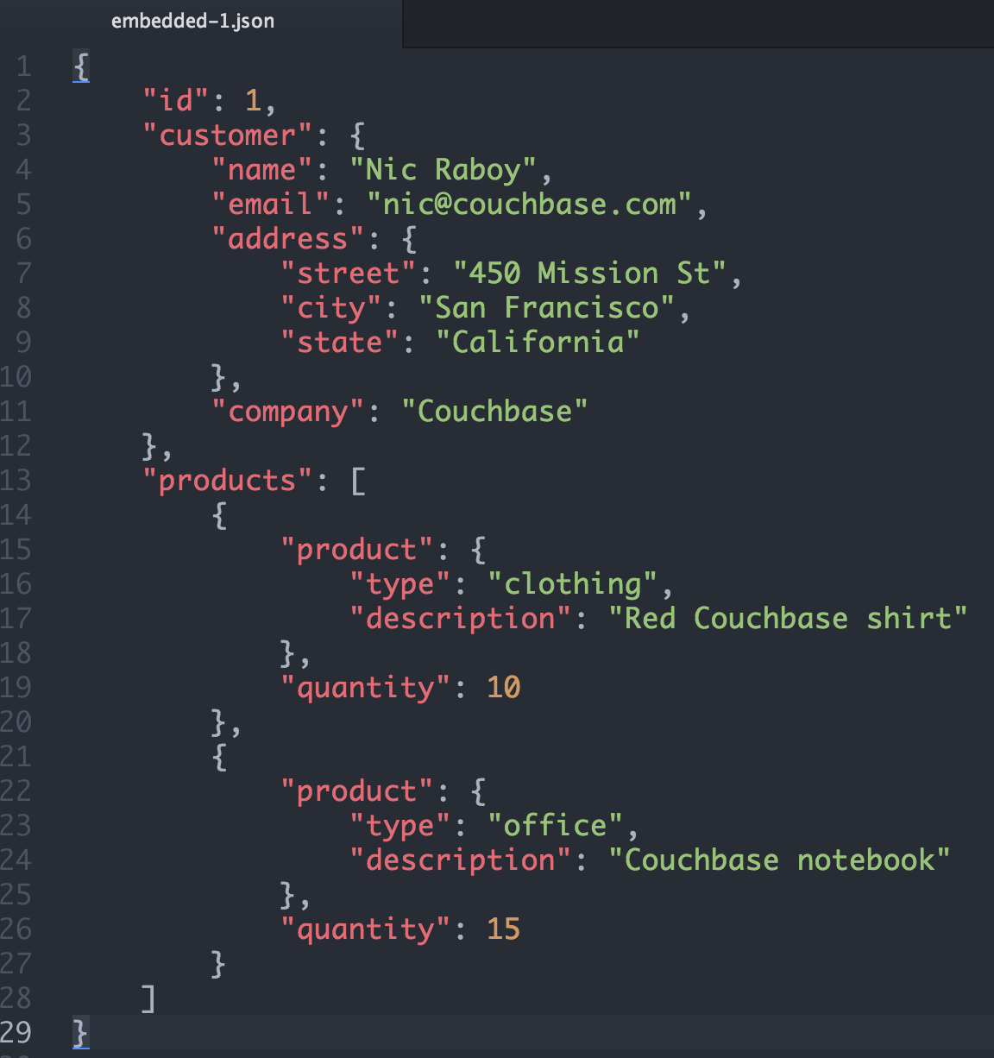
Embedded Document

Slide 19
When to embed
You should embed data when:
Speed trumps all else
Slow moving data
Application layer can keep multiple copies of same data in sync
Notes:
Denormalisation is the first thing many people think of when considering modelling for non-relational databases.
Of course, our

Slide 20
When to refer
You should refer to data when:
Consistency is a priority
The data has large growth potential
Notes:
Denormalisation is the first thing many people think of when considering modelling for non-relational databases.
Of course, our

Slide 21
Going Deeper…
Designing Documents & Their Keys

Slide 22
Three ways to build a key
Key design is as important as document design.
There are three broad types of key:
Human readable/deterministic: e.g. an email address
Computer generated/random: e.g. UUID
Compound: e.g. UUID with a deterministic portion
Notes:
Denormalisation is the first thing many people think of when considering modelling for non-relational databases.
Of course, our

Slide 23
Human readable/deterministic
public class user {
private String name;
private String email;
private String streetAddress;
private String city;
private String country;
private String postCode;
private Array orders;
private Array productsViewed;
}
{
"name": ”Nic Raboy",
"address": ”450 Mission Street",
"city": ”San Francisco",
"postCode": ”94105",
"orders": [ 1, 9, 698, 32 ],
“productsViewed”: [8, 33, 99, 100]
}
Key: nic@couchbase.com
Notes:
Denormalisation is the first thing many people think of when considering modelling for non-relational databases.
Of course, our

Slide 24
Random/computer generated
Key: 1001
{
"name": ”Nic Raboy",
"email": ”nic@couchbase.com",
"address": ”450 Mission Street",
"city": ”San Francisco",
"postCode": ”94105",
"orders": [ 1, 9, 698, 32 ],
“productsViewed”: [8, 33, 99, 100]
}
Notes:
Denormalisation is the first thing many people think of when considering modelling for non-relational databases.
Of course, our

Slide 25


Using counters to generate keys
Creating a new user
user_id = incr(“counter_key")
add(user_id, data)
Application
add(email_address, user_id)
Finding user by email address
key = get("nic@couchbase.com")
get(key)
Application
Notes:
Denormalisation is the first thing many people think of when considering modelling for non-relational databases.
Of course, our

Slide 26
Multiple look-up documents
u::count
1001
u::1001
{ "name": “Nic Raboy",
"facebook_id": 16172910,
"email": “nic@couchbase.com”,
“password”: ab02d#Jf02K
"created_at": "5/1/2012 2:30am",
“facebook_access_token”: xox0v2dje20,
“twitter_access_token”: 20jffieieaaixixj }
fb::16172910
1001
nflx::2939202
1001
twtr::2920283830
1001
em::nic@couchbase.com
1001
em::nic.raboy@couchbase.com
1001
uname::nraboy
1001
Notes:
Denormalisation is the first thing many people think of when considering modelling for non-relational databases.
Of course, our

Slide 27
Compound keys
Compound keys are look-up documents with a predictable name.
It’s a continuation of the embedded versus referred data discussion.
Notes:
Denormalisation is the first thing many people think of when considering modelling for non-relational databases.
Of course, our

Slide 28
Compound keys: example
u::1001
{
"name": ”Nic Raboy",
"email": ”nic@couchbase.com",
"address": ”450 Mission Street",
"city": ”San Francisco",
"postCode": ”94105",
"orders": [ 1, 9, 698, 32 ],
“productsViewed”: [8, 33, 99, 100]
}
Notes:
Denormalisation is the first thing many people think of when considering modelling for non-relational databases.
Of course, our

Slide 29
Compound keys: example
u::1001
{
"name": ”Nic Raboy",
"email": ”nic@couchbase.com",
"address": ”450 Mission Street",
"city": ”San Francisco",
"postCode": ”94105",
"orders": [ 1, 9, 698, 32 ]
}
u::1001::productsviewed
{
"productsList": [
8, 33, 99, 100
]
}
Notes:
Denormalisation is the first thing many people think of when considering modelling for non-relational databases.
Of course, our

Slide 30
Compound keys: example
u::1001
{
"name": ”Nic Raboy",
"email": ”nic@couchbase.com",
"address": ”450 Mission Street",
"city": ”San Francisco",
"postCode": ”94105",
"orders": [ 1, 9, 698, 32 ]
}
u::1001::productsviewed
{
"productsList": [
8, 33, 99, 100
]
}
p::8
{
id": 1,
"name": "T-shirt",
"description": "Red Couchbase shirt",
"quantityInStock": 99,
"image": "tshirt.jpg”
}
Notes:
Denormalisation is the first thing many people think of when considering modelling for non-relational databases.
Of course, our

Slide 31
Compound keys: example
u::1001
{
"name": ”Nic Raboy",
"email": ”nic@couchbase.com",
"address": ”450 Mission Street",
"city": ”San Francisco",
"postCode": ”94105",
"orders": [ 1, 9, 698, 32 ]
}
u::1001::productsviewed
{
"productsList": [
8, 33, 99, 100
]
}
p::8
{
id": 1,
"name": "T-shirt",
"description": "Red Couchbase shirt",
"quantityInStock": 99
}
p::8::img
“http://someurl.com/tshirt.jpg”
Notes:
Denormalisation is the first thing many people think of when considering modelling for non-relational databases.
Of course, our

Slide 32
Three ways to build a key
Human readable/deterministic: e.g. an email address
Computer generated/random: e.g. UUID
Compound: e.g. UUID with a deterministic portion
Notes:
Denormalisation is the first thing many people think of when considering modelling for non-relational databases.
Of course, our

Slide 33
How Do We Query This Data?

Slide 34
Querying the JSON profile
Look-up documents: i.e. manual secondary indexing (2i)
Couchbase views: i.e. automated secondary indexing (2i)
N1QL
Notes:
Actually, mostly it's KV and we're just looking for different ways of indexing what we're accessing. N1QL is a game changer.

Slide 35
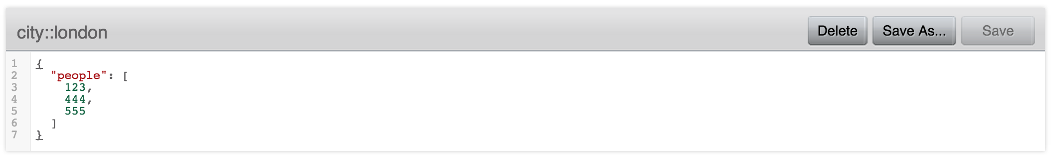
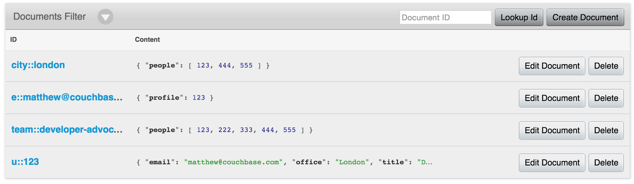
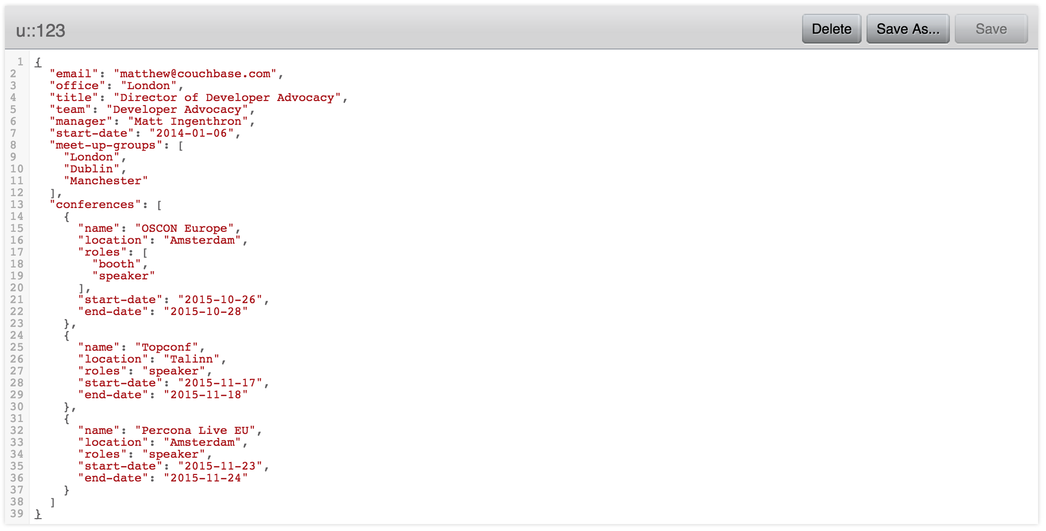
Manual 2i
Notes:
Manual 2i is fine enough but takes more work on the application side. Gives you the advantage of strong consistency.

Slide 36
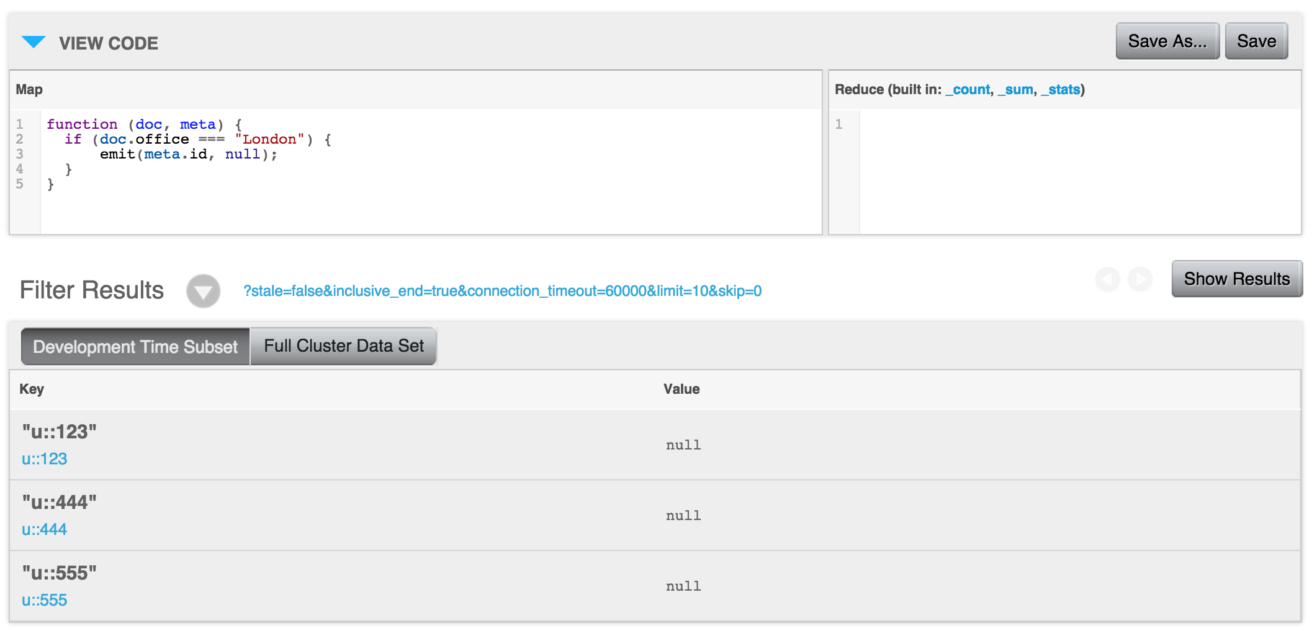
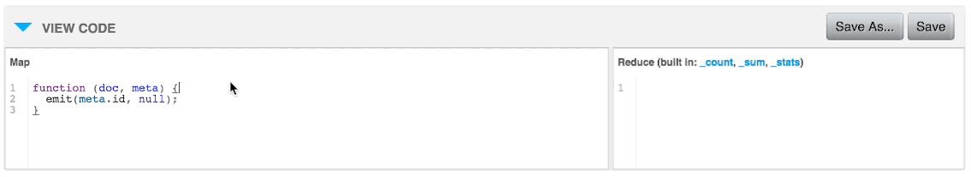
Automatic 2i: views
Notes:
Views let us automate that. View ain't going nowhere. Views might be the right way to index some stuff. Ultimately you're still doing KV but the indexes are slightly out of sync. Still, you're telling Couchbase how to go about giving you the data you want.

Slide 37
Querying With N1QL

Slide 38
What is N1QL?
N1QL is a new query language that systematically extends SQL to document-oriented data
N1QL extends SQL to handle data that is:
Nested: Contains nested objects, arrays
Heterogeneous: Schema-optional, non-uniform
Distributed: Partitioned across a cluster

Slide 39
Language Highlights
Standard SELECT pipeline
SELECT, FROM, WHERE, GROUP BY, ORDER BY, LIMIT, OFFSET
JOINs (by keys)
Subqueries
Aggregation
Set operators
UNION, INTERSECT, EXCEPT
EXPLAIN

Slide 40
Document-oriented Extensions
Nested
Paths—user.profile.email, children[0], children[0:2]
NEST, UNNEST
Ranging—FOR EVERY child IN children
Transformations—SELECT {“name”: first_name || last_name}
Non-uniform
IS MISSING
Type checking and conversion
Distributed
Direct lookup—USE KEYS
Efficient joins—ON KEYS

Slide 41
Metadata access
Couchbase has metadata about documents in addition to the document values itself.
The META() function allows for this kind of access
select META(`travel-sample`) from `travel-sample` limit 1; {
"$1": {
"cas": 1.60955901476865e+14,
"flags": 0,
"id": "landmark_25257",
"type": "json"
}
}

Slide 42
Offloading computation to N1QL
N1QL allows you to choose which elements are returned at the top level. This is incredibly useful as it reduces the need to write complex parsing logic:
Within the application.
In Client side front end frameworks (Angular/Backbone etc)
Notes:
Denormalisation is the first thing many people think of when considering modelling for non-relational databases.
Of course, our

Slide 43
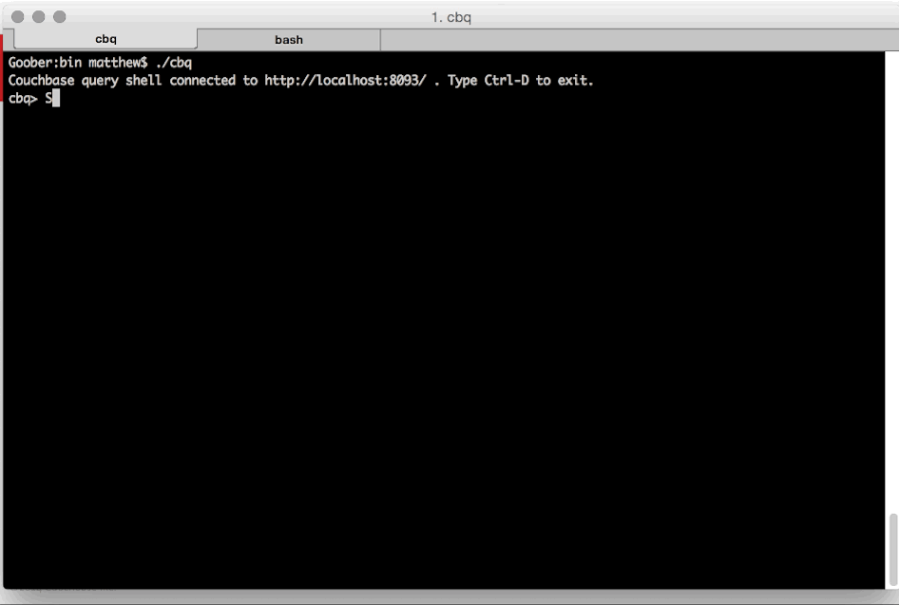
N1QL
Notes:
N1QL changes all that. With N1QL you tell Couchbase what you want and it worries about the detail of how to get it.
We're leaving KV behind entirely here. Importantly, the results you get back no longer have to match the exact documents stored in the database. You can use N1QL to get the data you want, rather than having to mangle all that on the application side.

Slide 44
SELECT
Notes:
SELECT is the workhorse of N1QL. This is where you'll most likely spend your time.

Slide 45
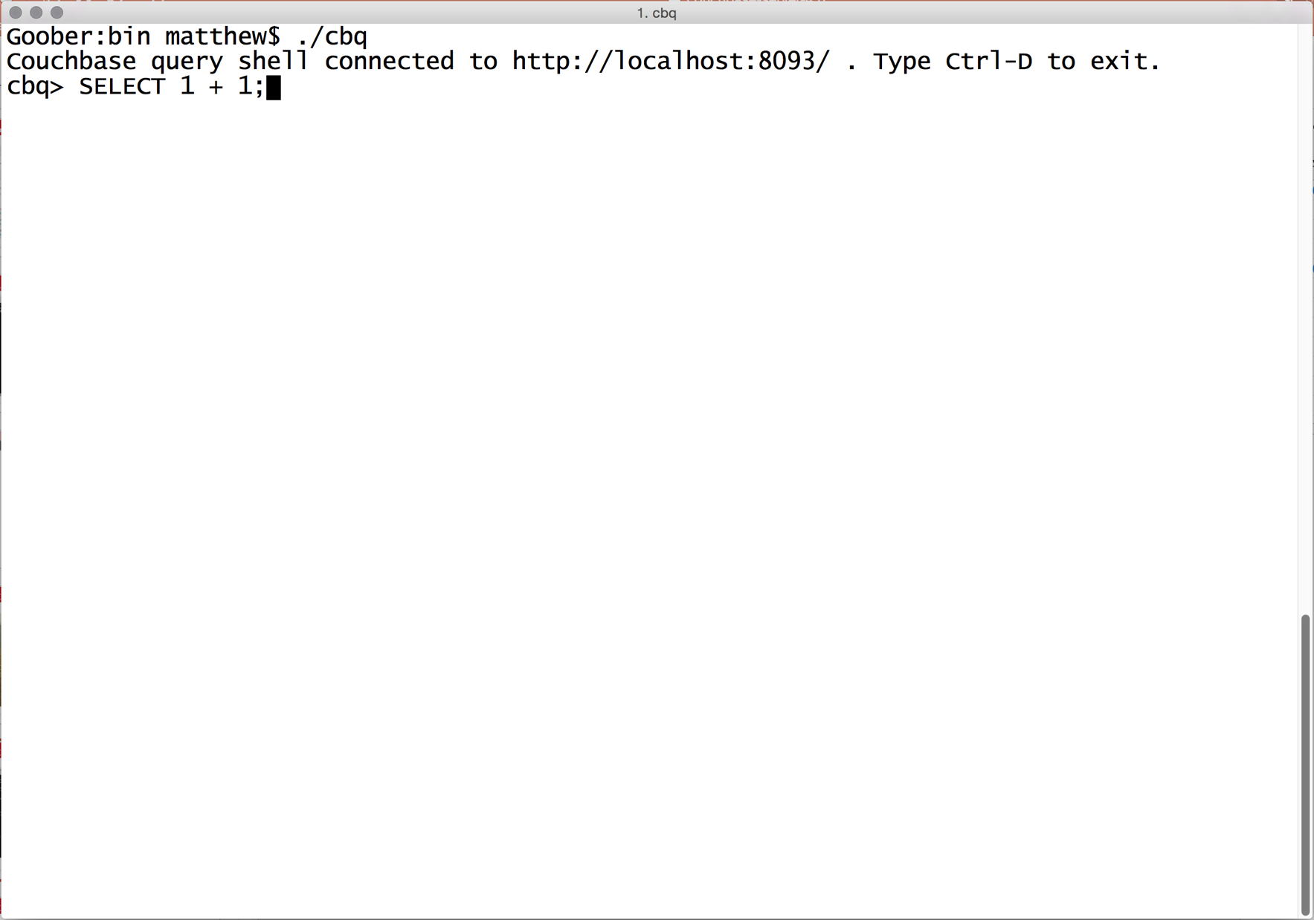
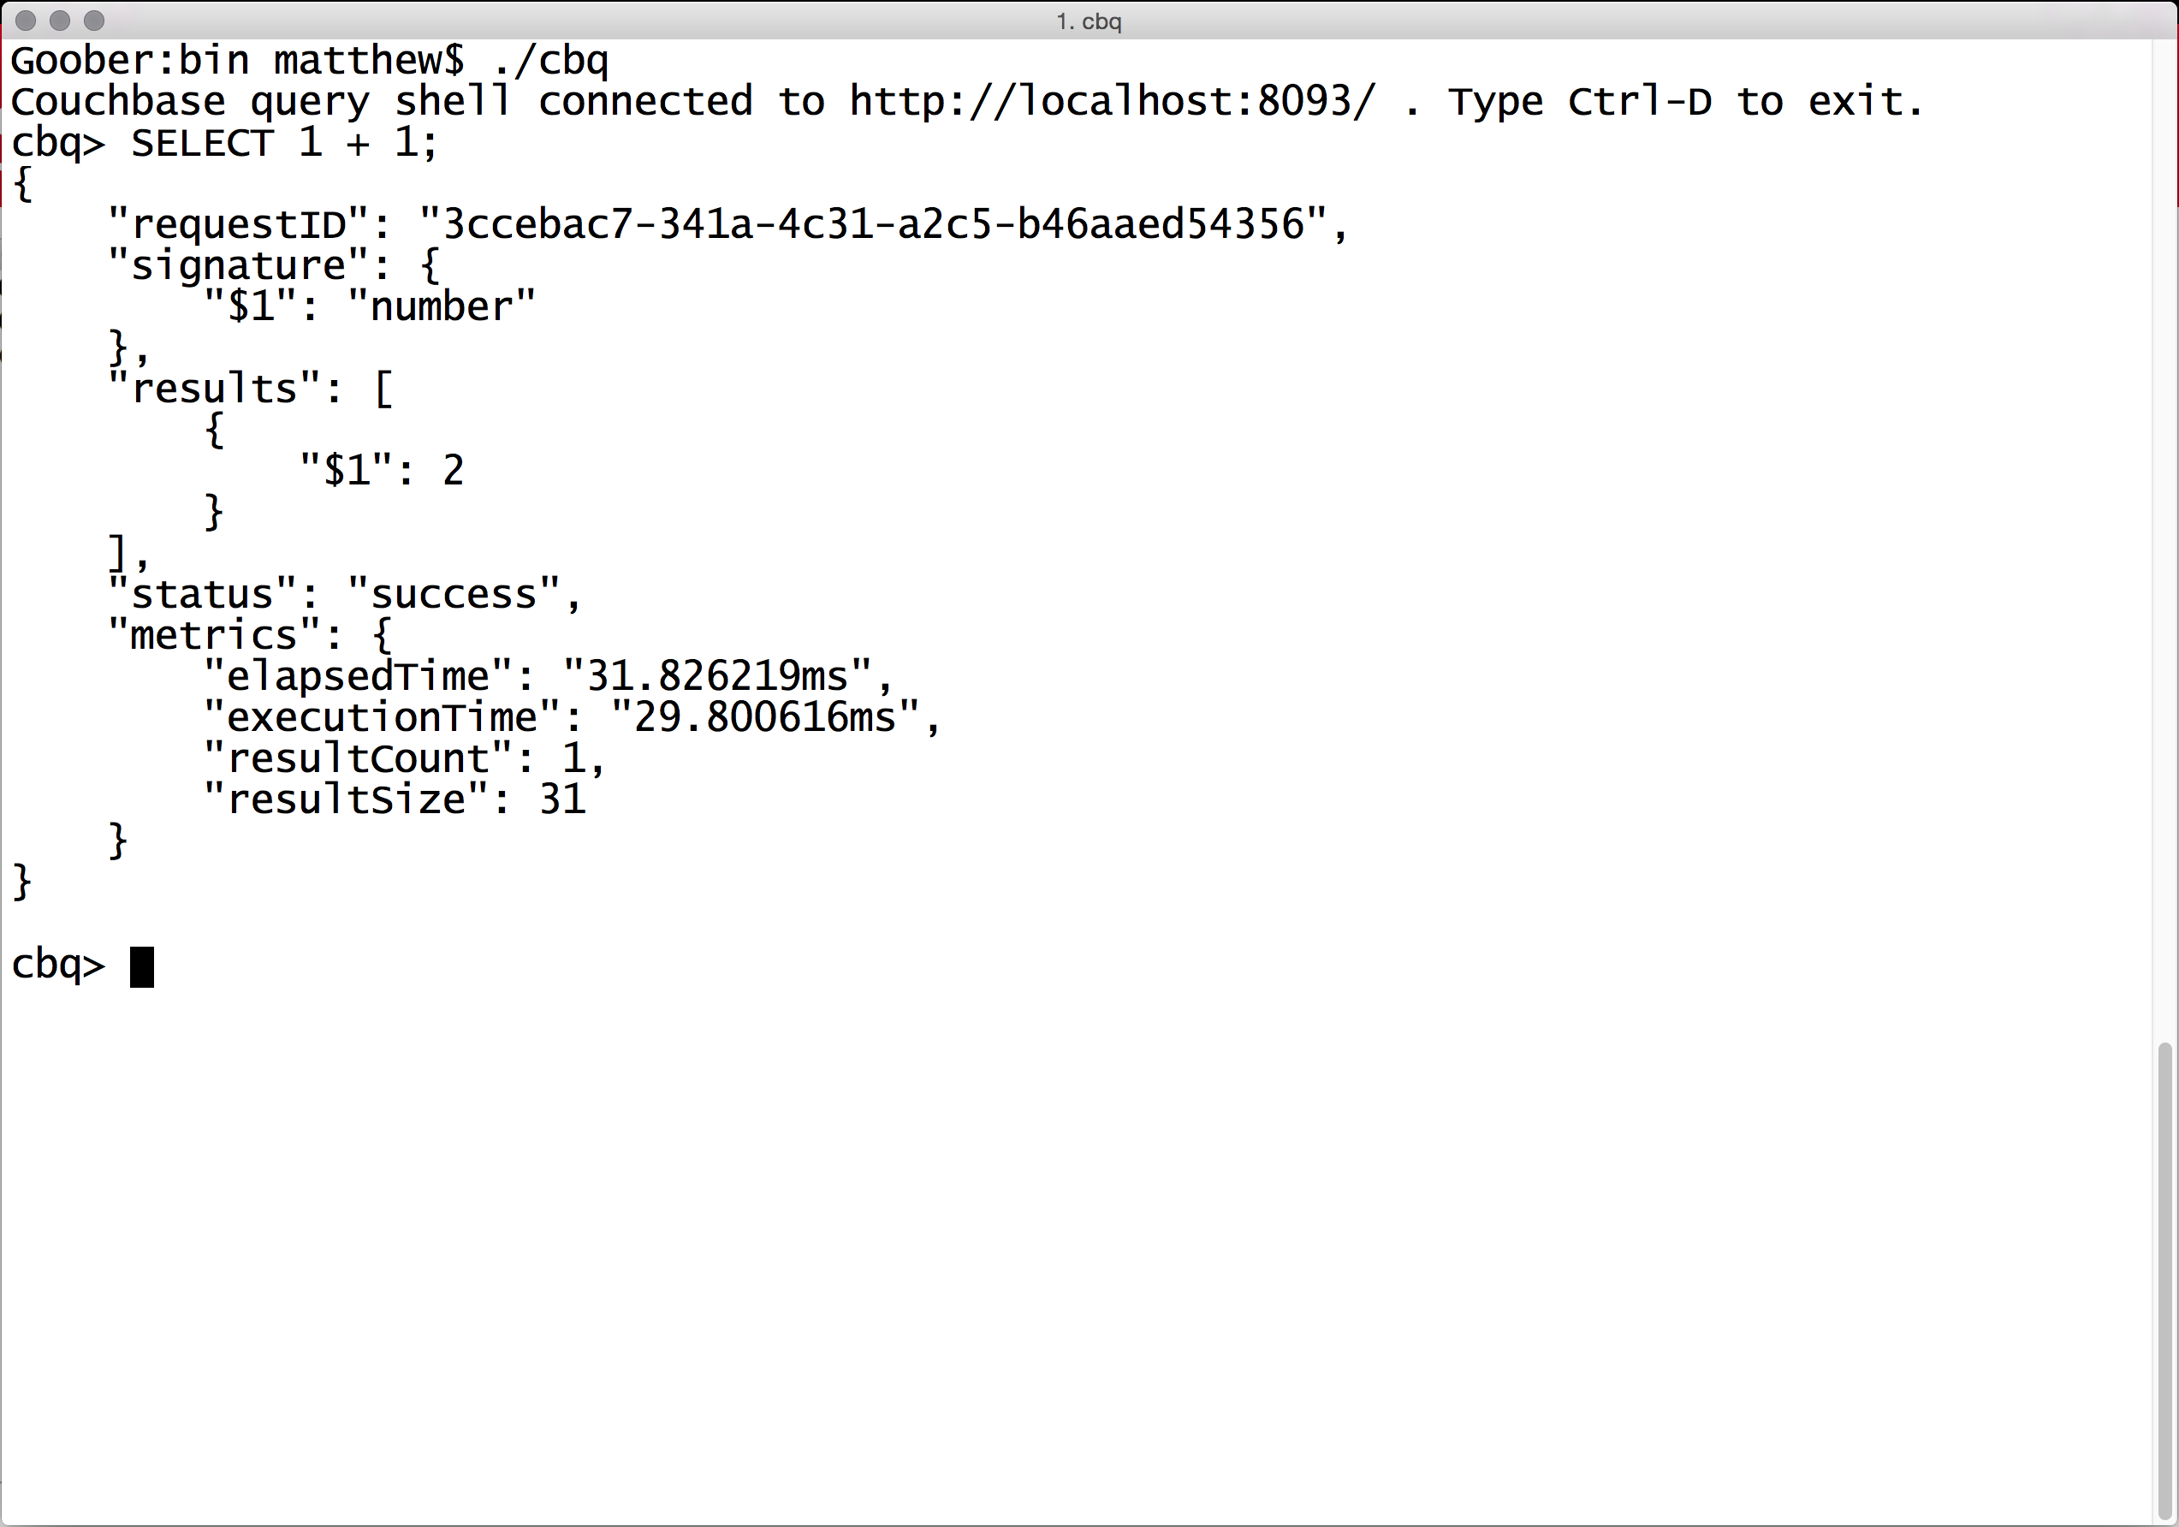
SELECT
SELECT 1 + 1;
Notes:
With N1Ql everything you get back is JSON. It gives you a bunch of metadata around the result itself to help you know how to handle the result or the error.

Slide 46
SELECT COUNT(*)
FROM `default`
WHERE office = "London";

Slide 47
{
"requestID": "6e733000-ac83-44ba-95a7-9b012e9c553d",
"signature": {
"$1": "number"
},
"results": [
{
"$1": 6
}
],
"status": "success",
"metrics": {
"elapsedTime": "18.603124ms",
"executionTime": "18.327696ms",
"resultCount": 1,
"resultSize": 31
}
}

Slide 48
SELECT email FROM `default`
WHERE office = "London";

Slide 49
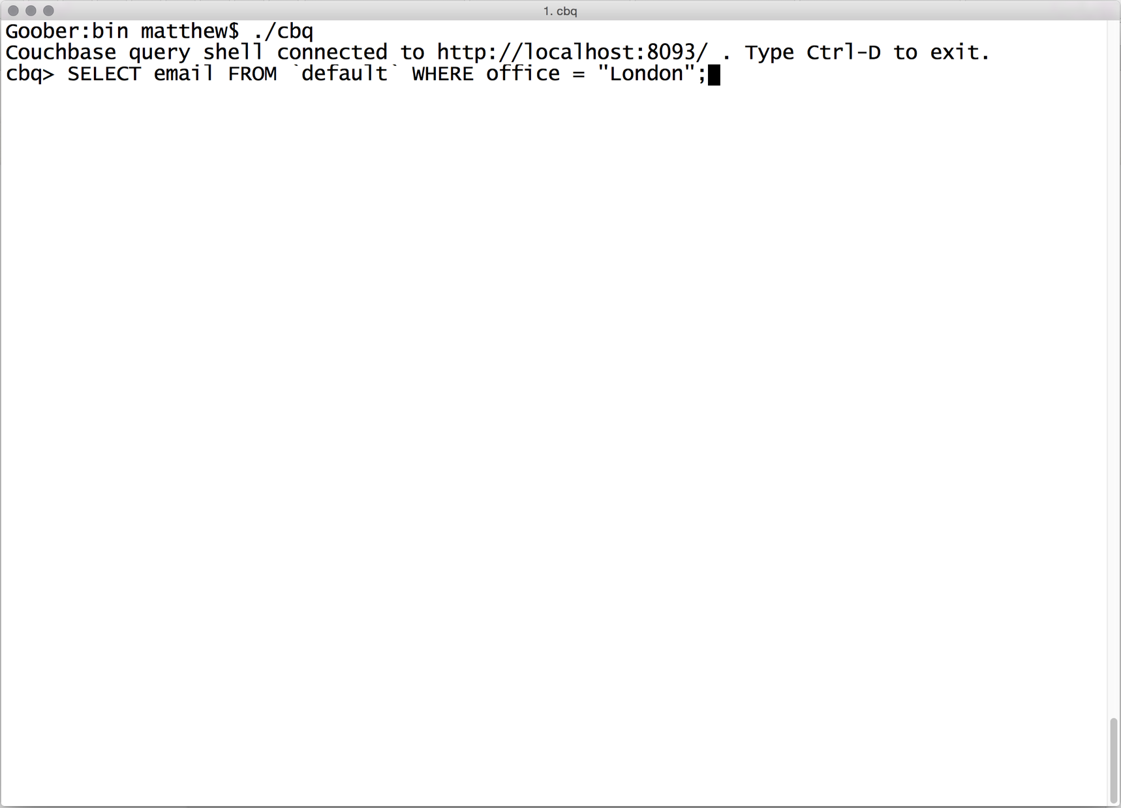
SELECT
Notes:
Let's get the email addresses for everyone in the London office.

Slide 50
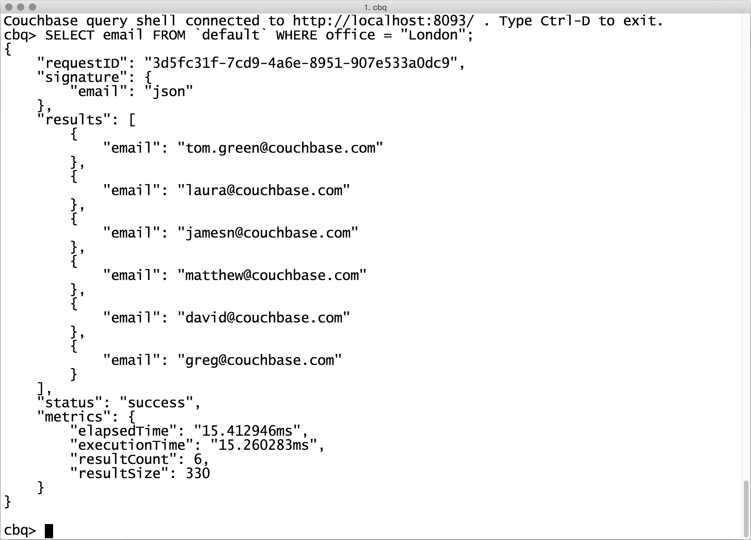

Slide 51
SELECT email FROM `default`
WHERE office = "London"
AND team = "Developer Advocacy";

Slide 52
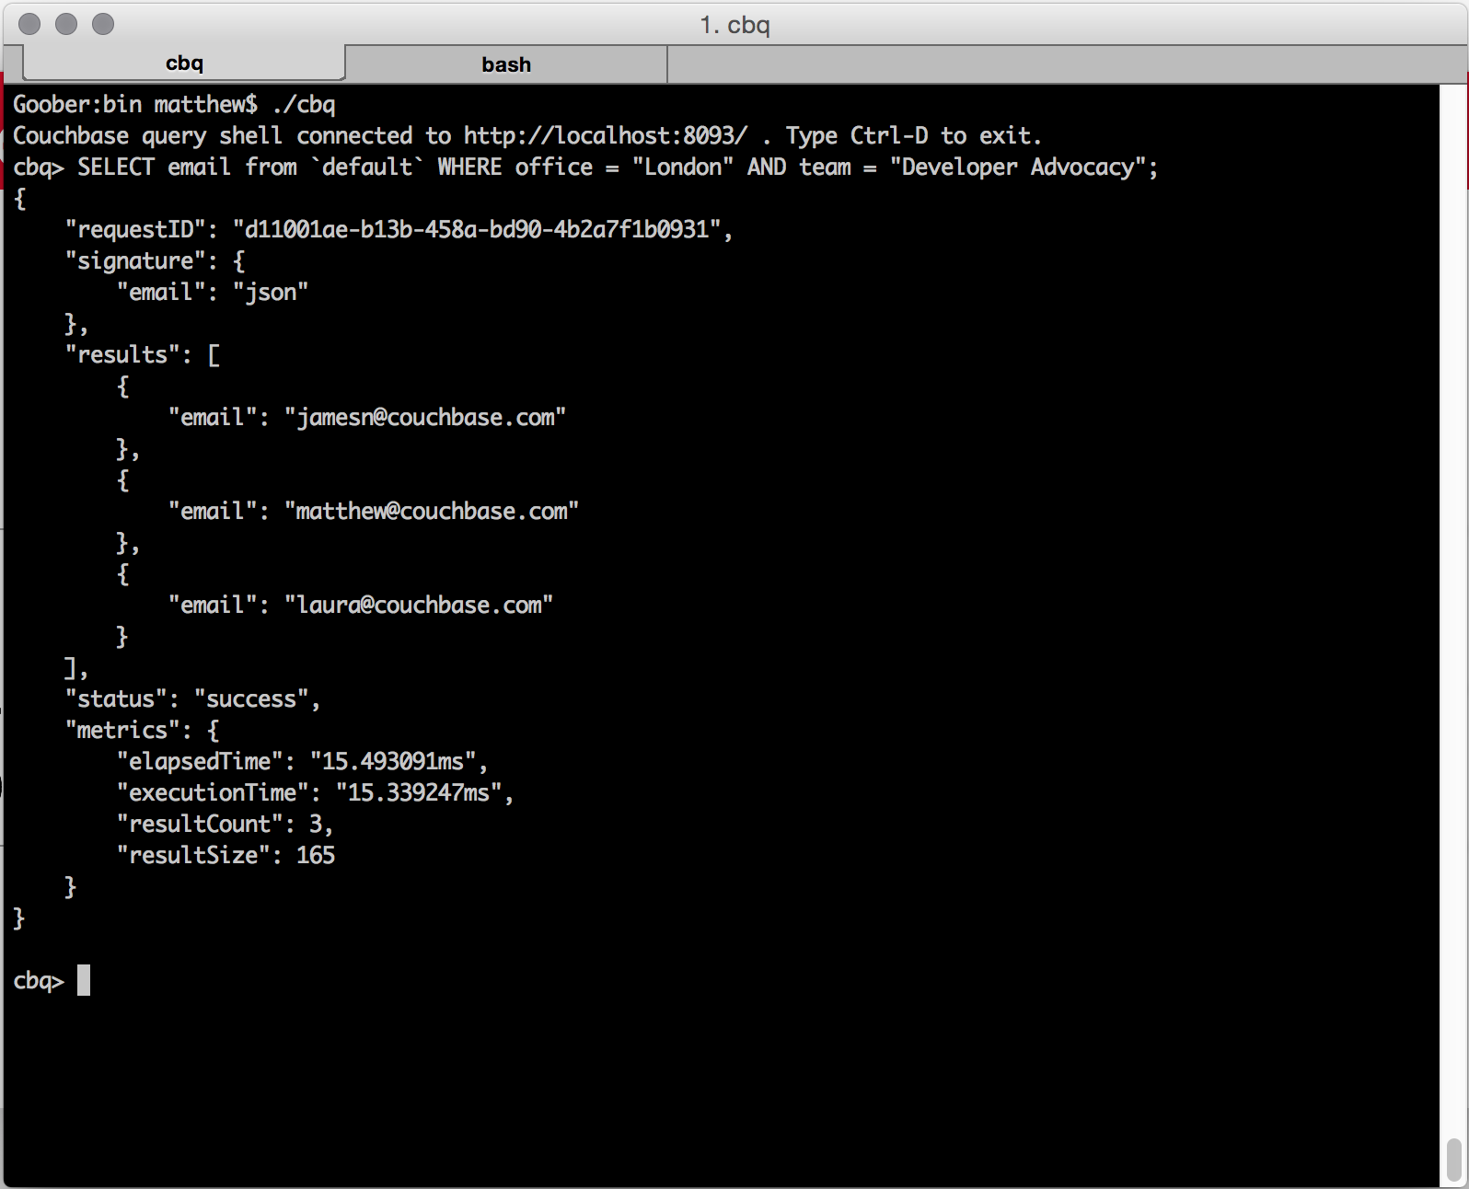
SELECT
Notes:
And now, just everyone in London who is in the Developer Advocacy team.

Slide 53
SELECT email FROM `default`
WHERE office = "London"
AND team != "Developer Advocacy";

Slide 54
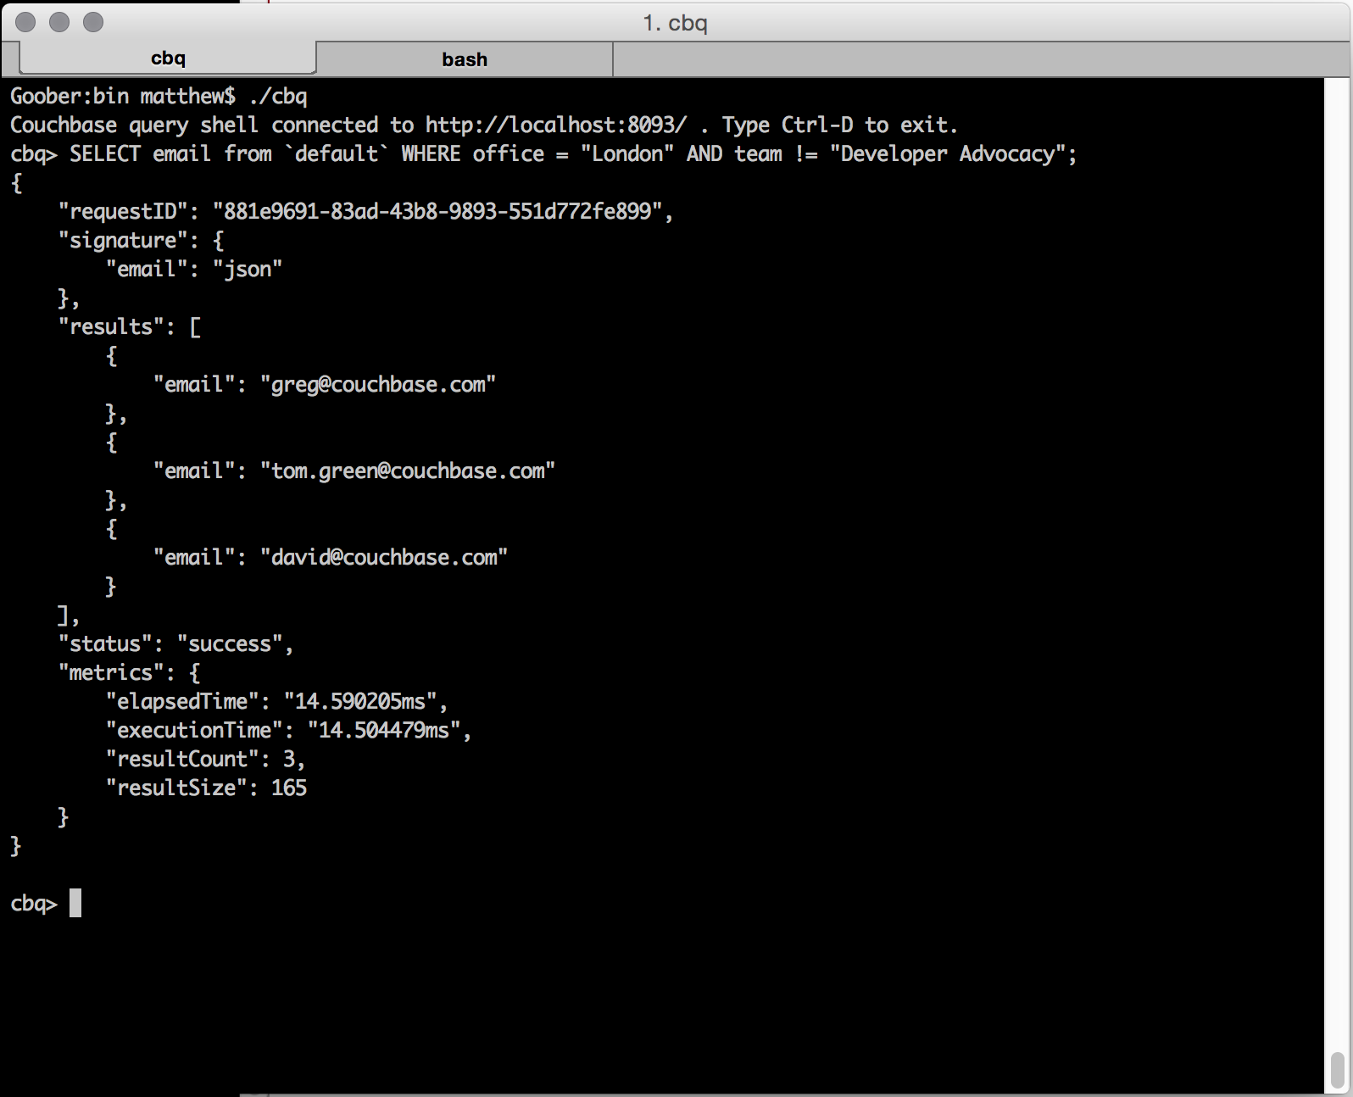
SELECT
Notes:
Equally, we can find the Londoners who *aren't* in the DA team.

Slide 55
But this is JSON
Notes:
Okay, so far so SQL. We have a JSON database here, though, so how do we dive into that JSON?

Slide 56
ARRAY ELEMENTS
SELECT conferences[0].name
AS event_name
FROM `default`;
Notes:
In our small data set we have an array for some people that shows which conferences they're attending.
We know the name of the array – conferences – and we can go down into the array by specifing the layer at which we'll find the sub-key.
In our results here we get back all the conferences people are attending. We also get back some blanks because this is a schema unenforced database. N1QL copes gracefully with missing data because real world data is messy.

Slide 57
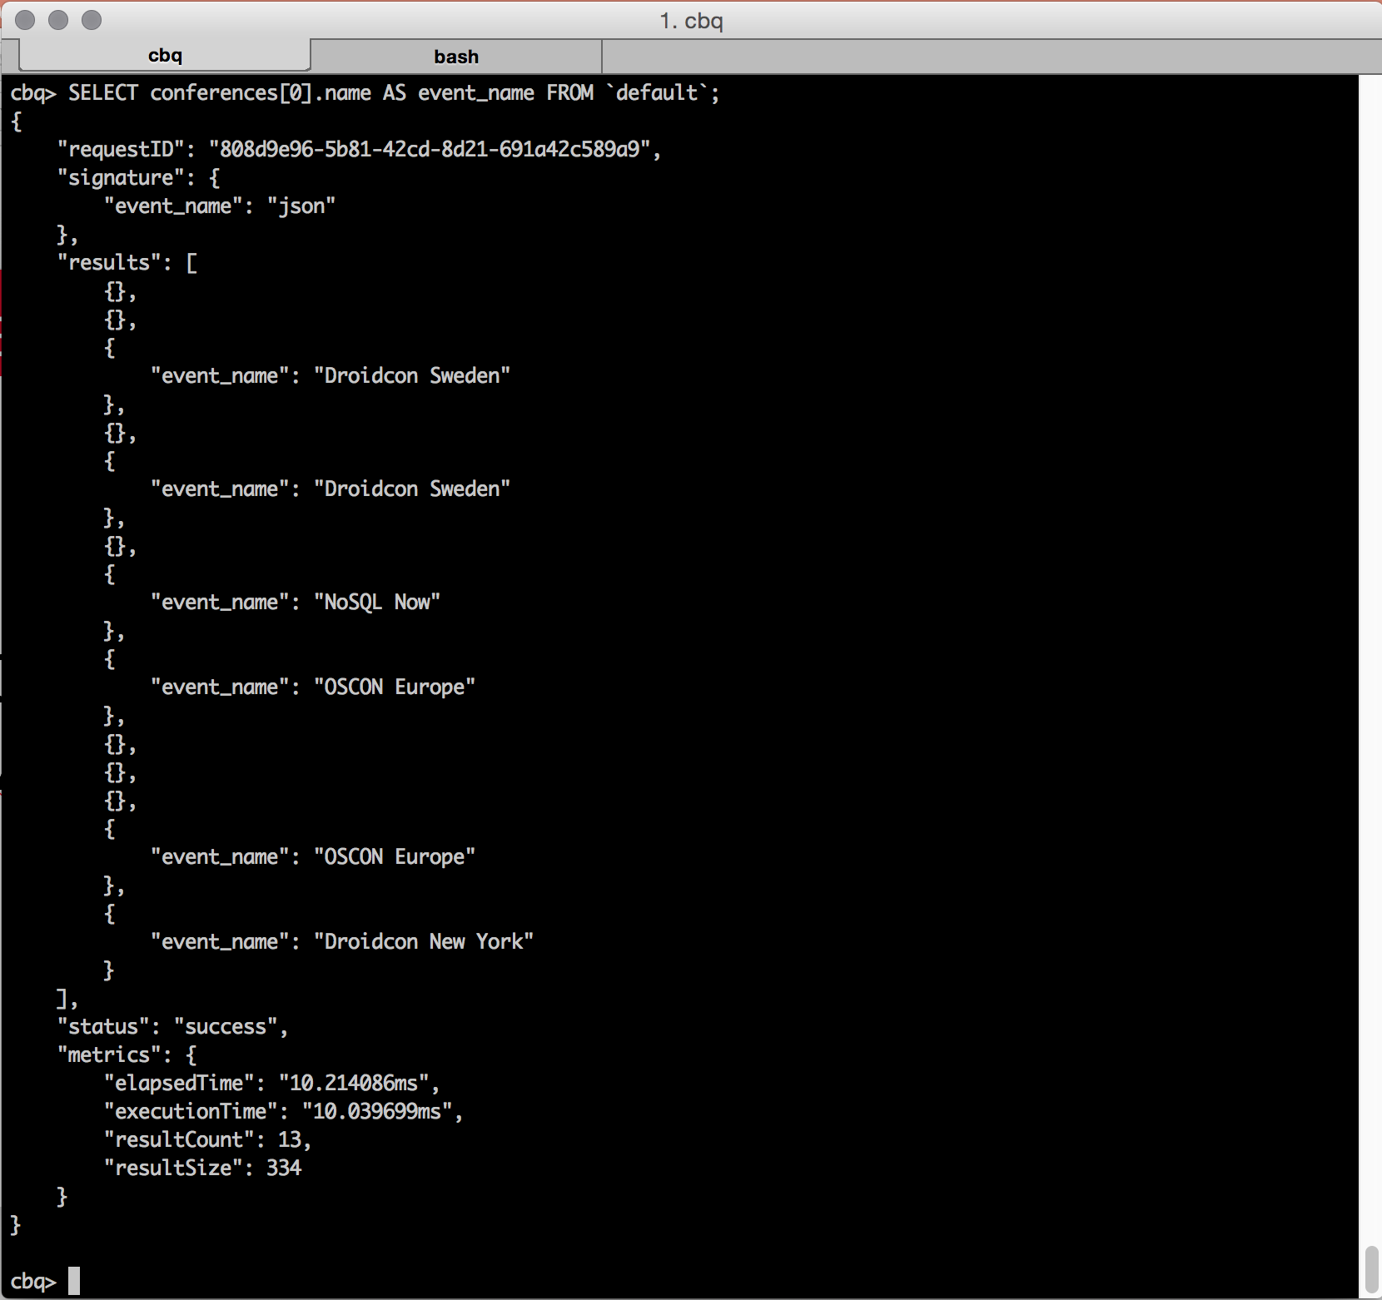
ARRAY ELEMENTS
Notes:
In our small data set we have an array for some people that shows which conferences they're attending.
We know the name of the array – conferences – and we can go down into the array by specifing the layer at which we'll find the sub-key.
In our results here we get back all the conferences people are attending. We also get back some blanks because this is a schema unenforced database. N1QL copes gracefully with missing data because real world data is messy.

Slide 58
DISTINCT ARRAY ELEMENTS
SELECT DISTINCT
conferences[0].name
AS event_name FROM `default`;
Notes:
We don't want our results to be messy, though. So let's strip out some of that duplication but requesting DISTINCT conference names.
We're still get that blank result but only once this time. We don't really want that in our results as what we want is a list of conferences.

Slide 59
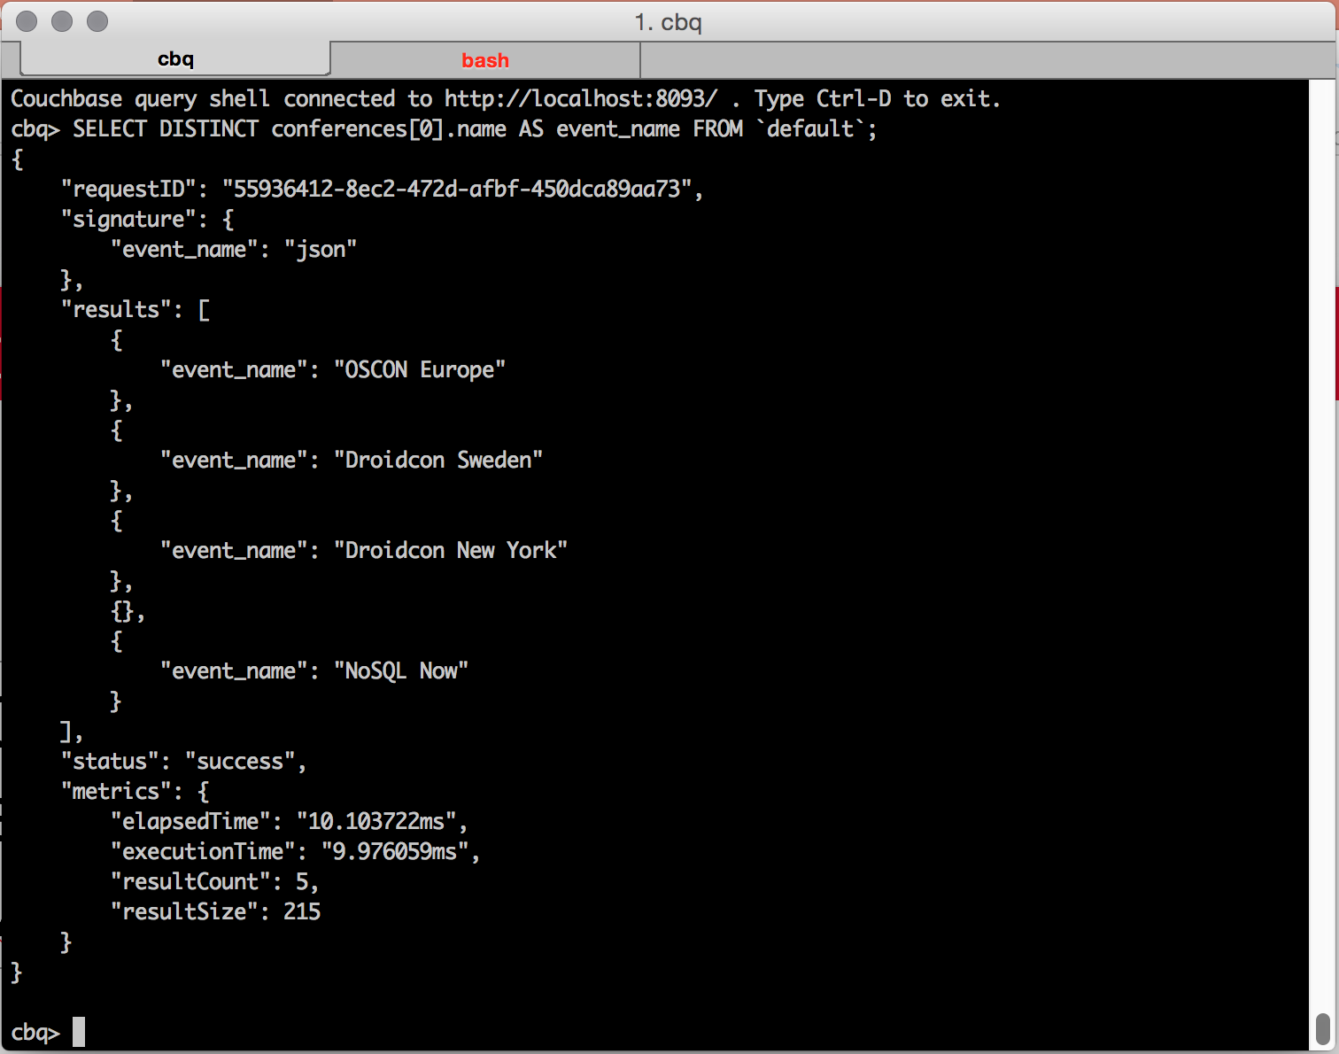
DISTINCT ARRAY ELEMENTS
Notes:
We don't want our results to be messy, though. So let's strip out some of that duplication but requesting DISTINCT conference names.
We're still get that blank result but only once this time. We don't really want that in our results as what we want is a list of conferences.

Slide 60
REMOVE MISSING ITEMS
SELECT DISTINCT
conferences[0].name
AS event_name FROM `default`
WHERE conferences
IS NOT MISSING;
Notes:
N1QL gives us the MISSING command. We can use IS NOT MISSING to make sure that what we get back are the conference names from only the documents that have a conference name.

Slide 61
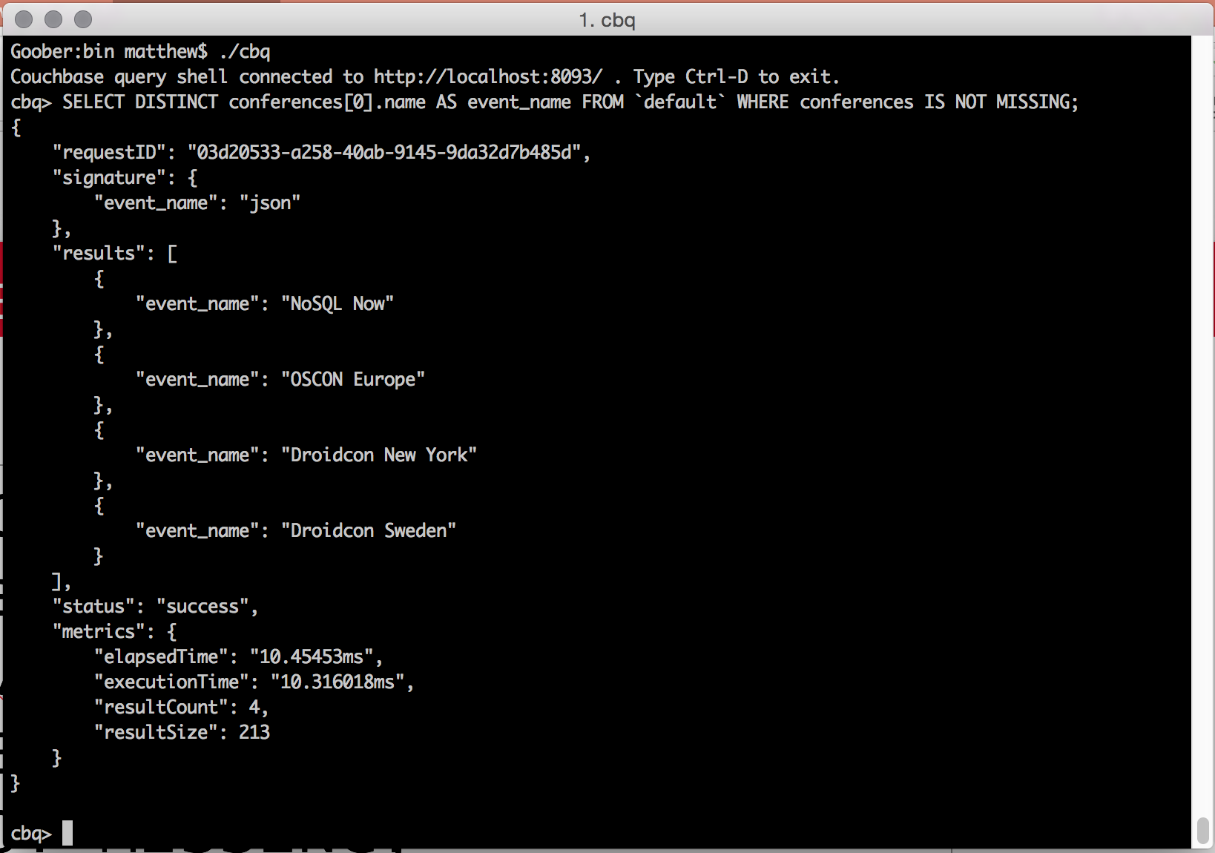
REMOVE MISSING ITEMS
Notes:
N1QL gives us the MISSING command. We can use IS NOT MISSING to make sure that what we get back are the conference names from only the documents that have a conference name.

Slide 62
WHO IS GOING TO DROIDCON SWEDEN?
SELECT email AS person,
conferences[0].name AS event
FROM `default`
WHERE ANY event in conferences
SATISFIES event.name =
"Droidcon Sweden" END;
Notes:
Now, let's plan our trip to Droidcon Sweden. Again, we can dive into nested data in our JSON to look for the conference name. Here we can use N1QL's SATISFIES to find the conference name inside the conferences array.

Slide 63
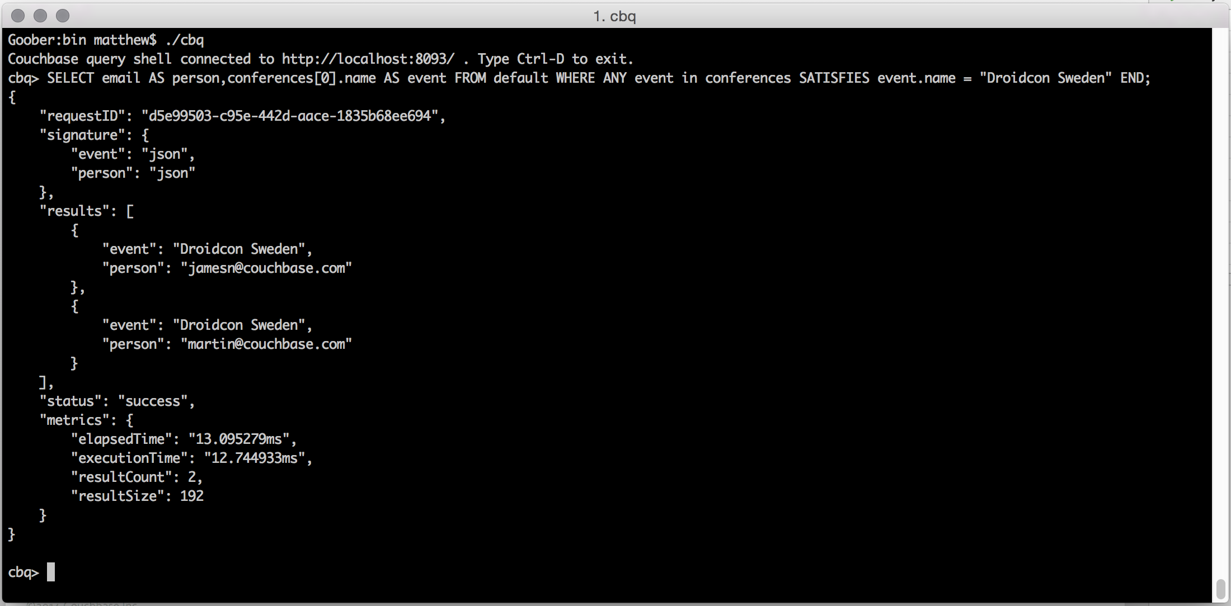
WHO IS GOING TO DROIDCON SWEDEN?
Notes:
Now, let's plan our trip to Droidcon Sweden. Again, we can dive into nested data in our JSON to look for the conference name. Here we can use N1QL's SATISFIES to find the conference name inside the conferences array.

Slide 64
What's going on underneath?

Slide 65
EXPLAIN
EXPLAIN SELECT email AS person,
conferences[0].name AS event
FROM `default`
WHERE ANY event in conferences
SATISFIES event.name =
"Droidcon Sweden" END;
Notes:
It's good to know what's going on underneath. EXPLAIN lets us see into the query engine and how it is getting back the data we're looking for. Particularly useful for when results aren't as expected.

Slide 66
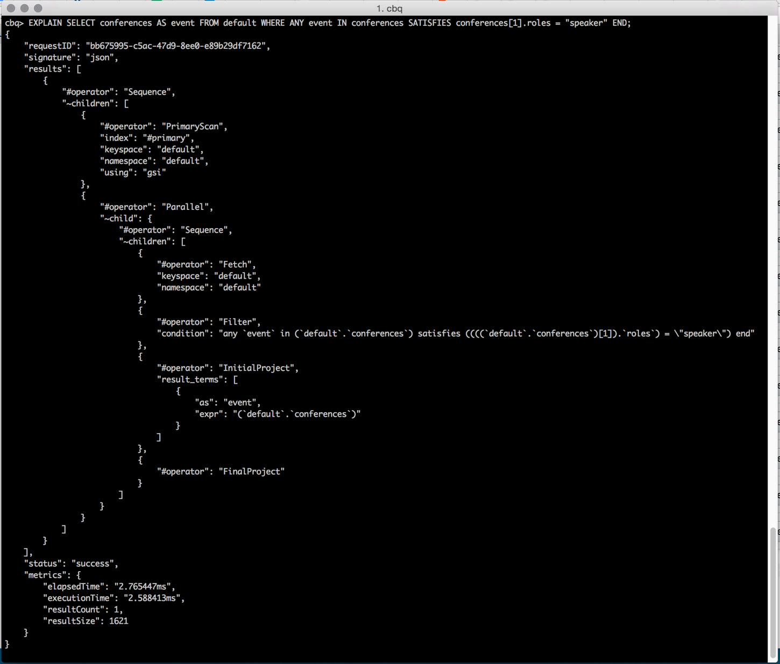
EXPLAIN
Notes:
It's good to know what's going on underneath. EXPLAIN lets us see into the query engine and how it is getting back the data we're looking for. Particularly useful for when results aren't as expected.

Slide 67
Surely I can write too?
Notes:
Okay, so we had a little fun but what about something more realistic? CB 4.0 comes with the travel-sample data set. Let's have a place.

Slide 68
Updating and deleting
DELETE: provide the key to delete the document
INSERT: provide a key and some JSON to create a new document
UPSERT: as INSERT but will overwrite existing docs
UPDATE: change individual values inside existing docs

Slide 69
A larger data-set: travel-sample
Notes:
Okay, so we had a little fun but what about something more realistic? CB 4.0 comes with the travel-sample data set. Let's have a place.

Slide 70
TRAVEL SAMPLE DATA
Notes:
It gives us airports, airlines, routes and that translates into flights.

Slide 71
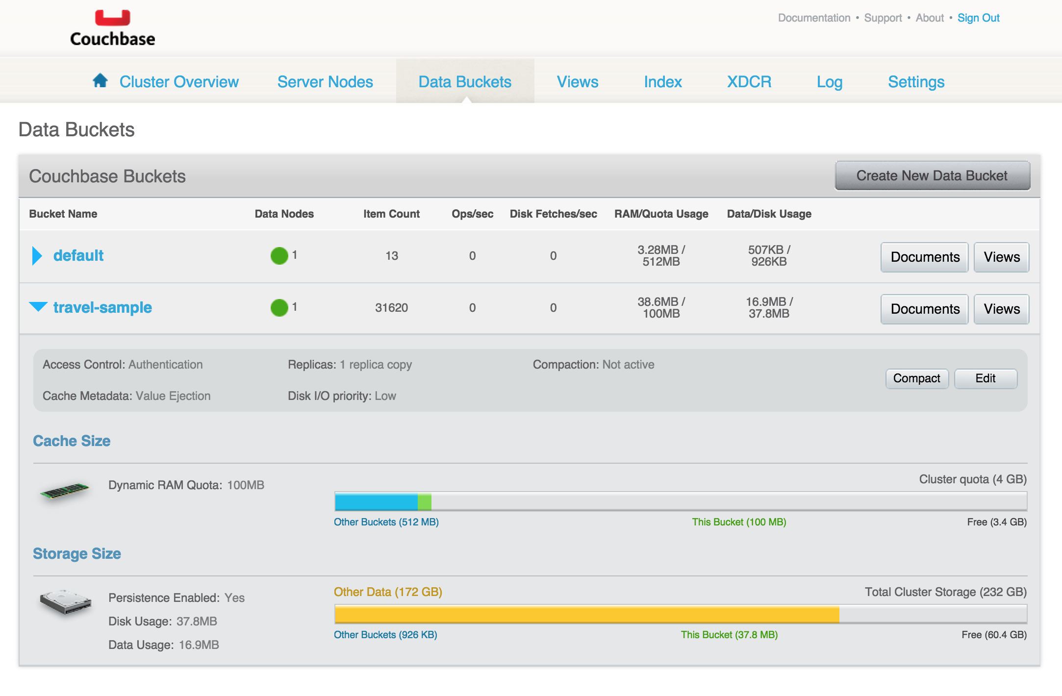
travel-sample
Notes:
We're dealing with almost 32k records, so it's a chunkier data set to play with.

Slide 72
CREATE PRIMARY INDEX
CREATE PRIMARY INDEX
ON `travel-sample`
USING GSI;
Notes:
Talk about indexing. Touch on GSI and views. Every bucket needs one index.
Why do we make you create a PRIMARY index? Why isn't it there by default? Well, it takes resource to make and maintain the index. If you don't want N1QL, we don't want to waste your resources by creating an index you don't need.

Slide 73
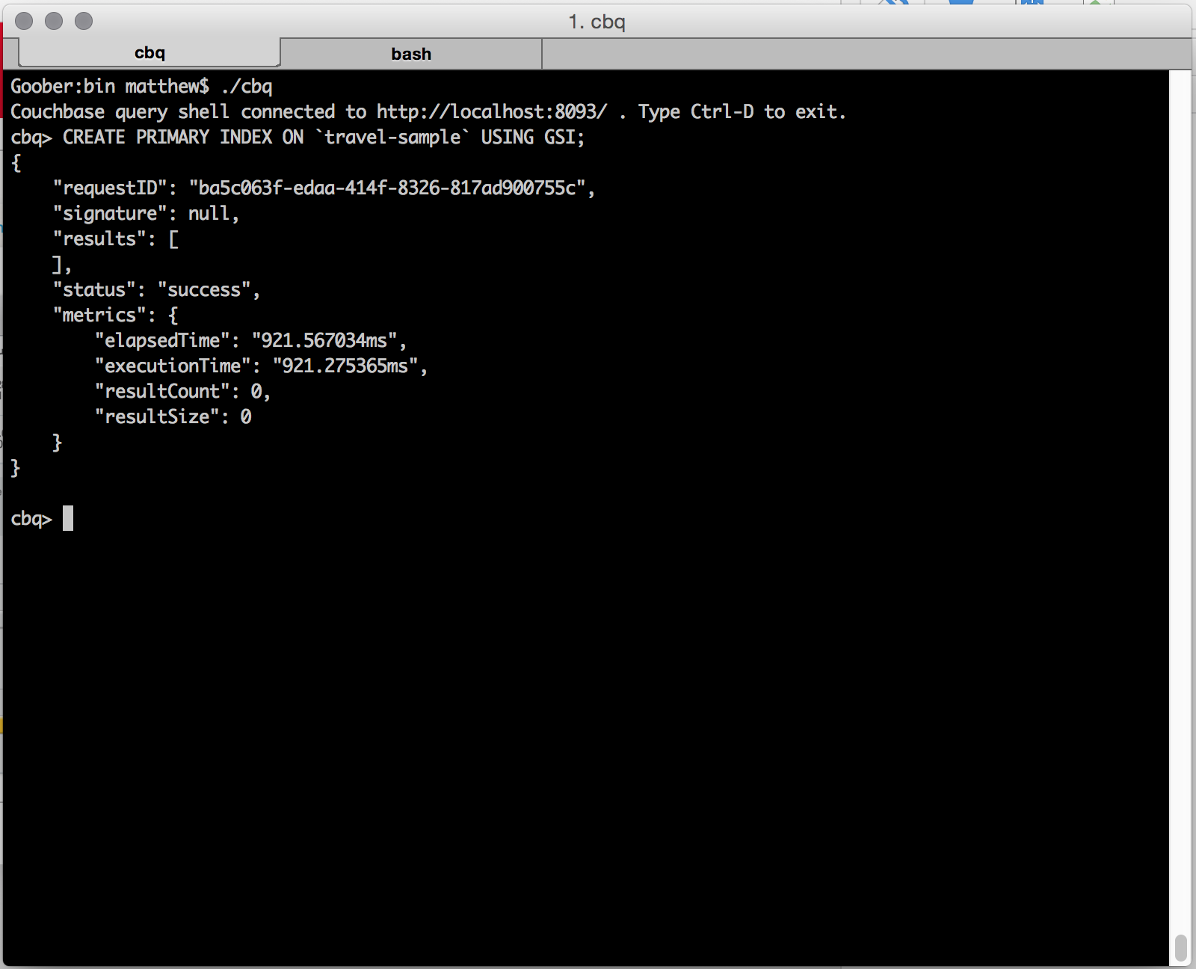

Slide 74
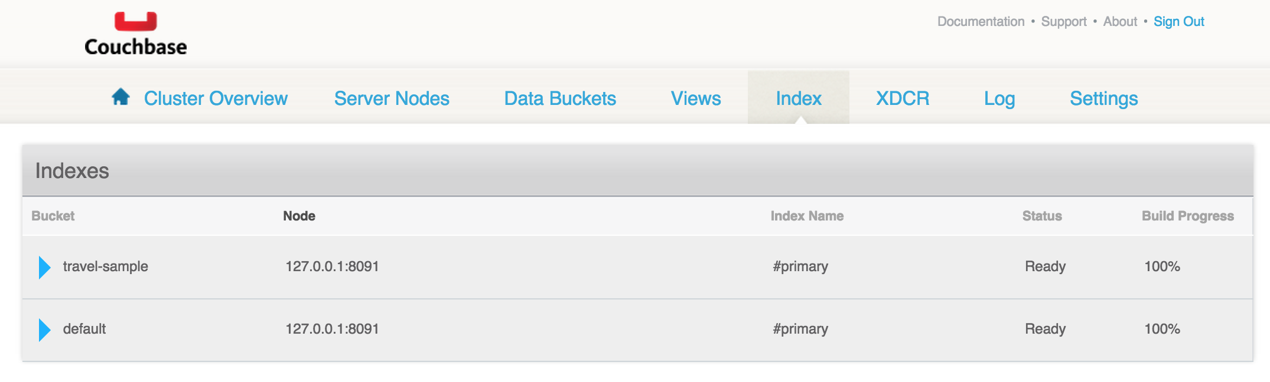

Slide 75
SELECT
SELECT * FROM `travel-sample`
WHERE type = "airline";
Notes:
Let's try something simple.

Slide 76
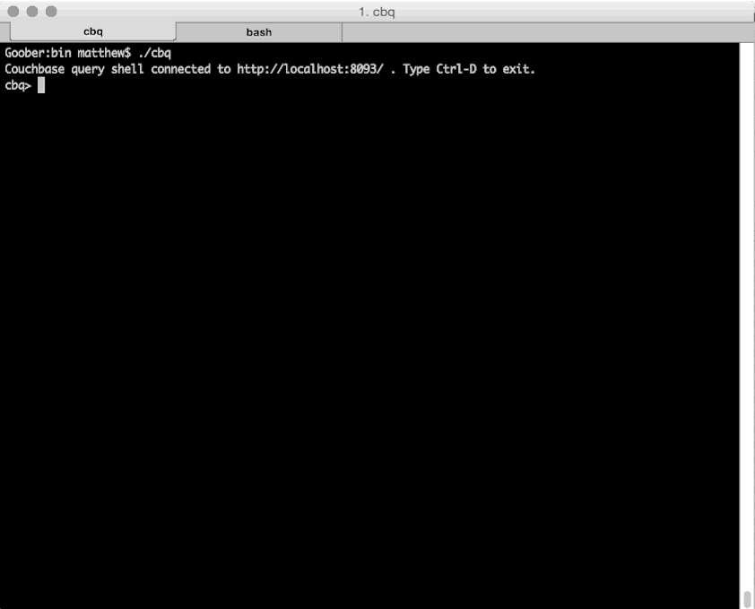
SELECT
Notes:
We get back 187 airlines and it took us nearly half a second.

Slide 77
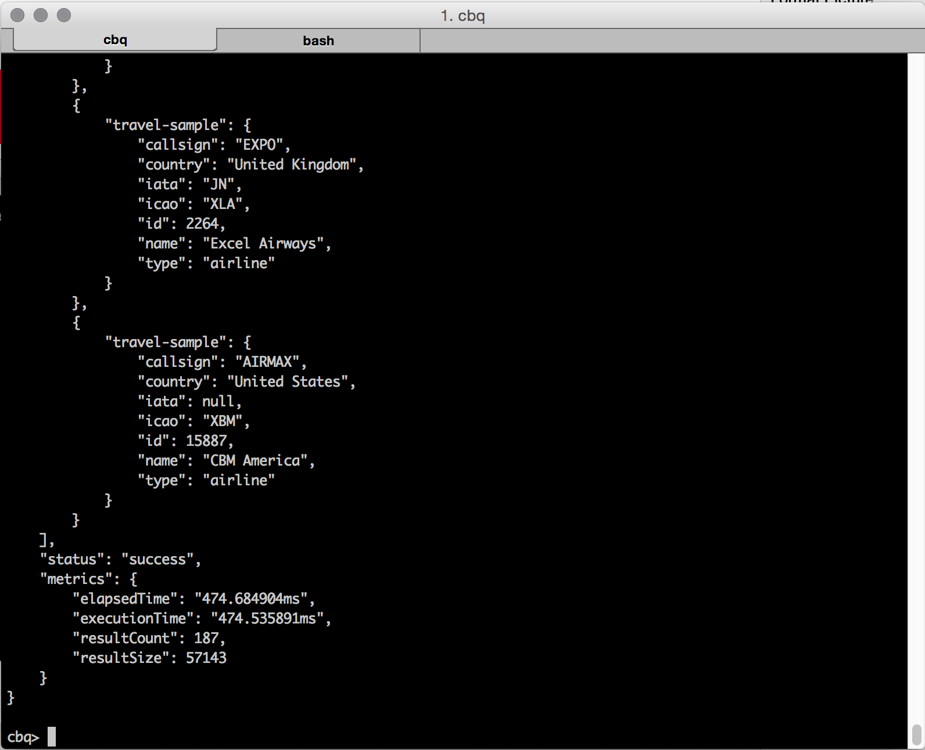

Slide 78
SELECT
SELECT * FROM `travel-sample`
WHERE type = "airline"
AND country = "United States";
Notes:
It might be more useful to narrow our focus. let's find airlines from the US.

Slide 79

SELECT
Notes:
It's still taking us a good half second to get a result back. If we did an EXPLAIN now we'd see that we're doing a full scan of the bucket. Couchbase is going through each of the 32k docs and checking each one to see if it has type=airline and country=United States. That's why it's taking a long time.

Slide 80
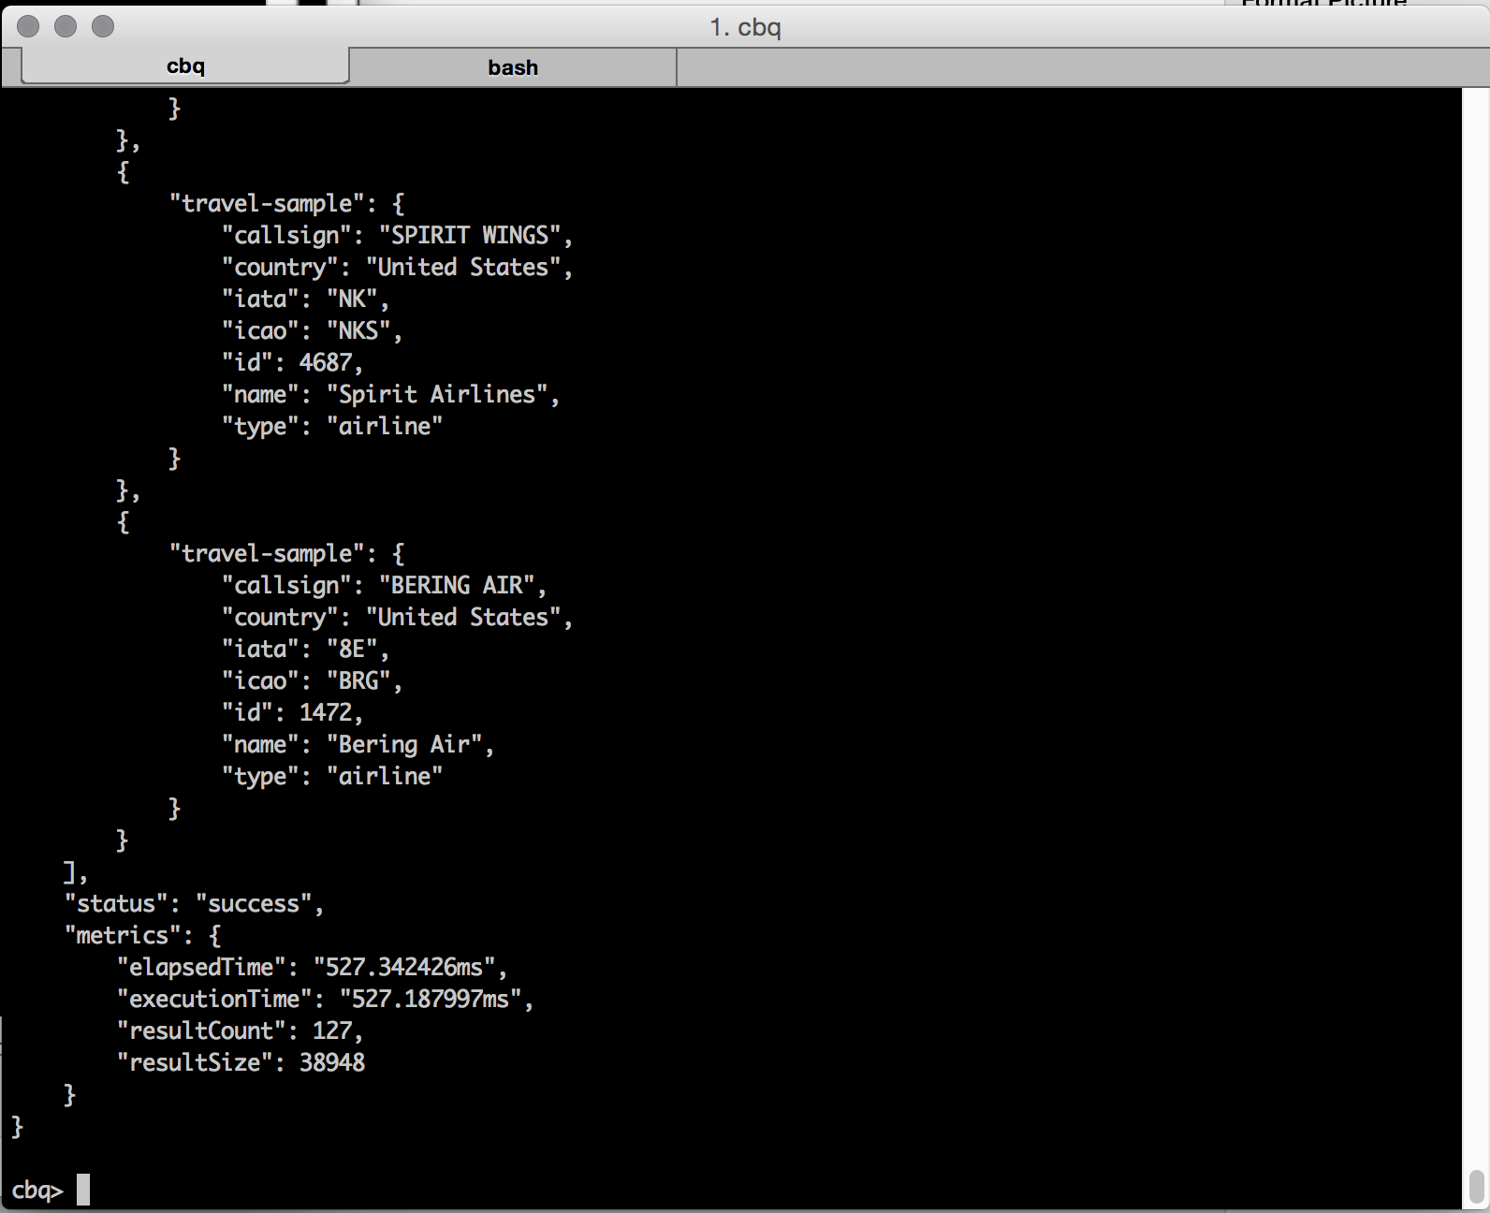

Slide 81
Indexes

Slide 82
CREATE INDEX airline
ON `travel-sample`(type)
WHERE type = "airline"
USING GSI;

Slide 83
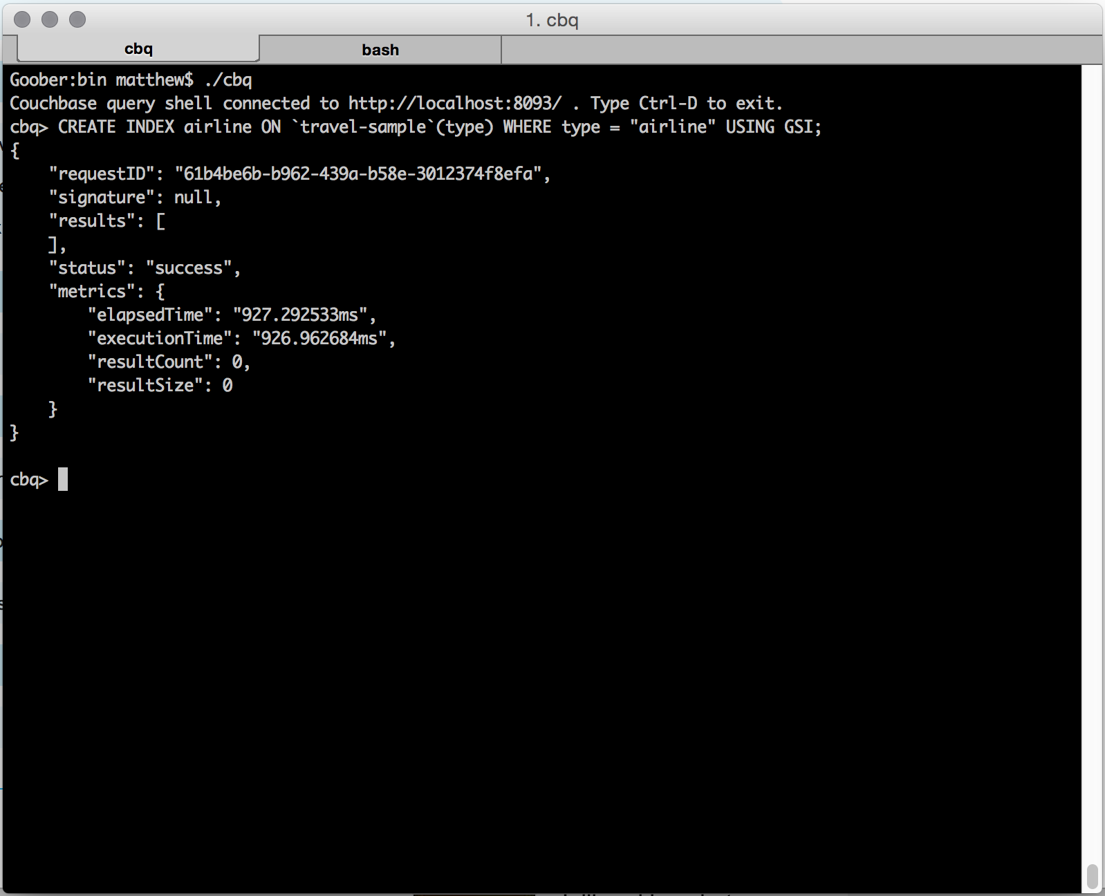
CREATE INDEX
Notes:
Indexes are not just for the primary key. We can create secondary indexes on the data. Here we're creating an index of all the airlines, using CB 4.0's new GSI indexing.

Slide 84
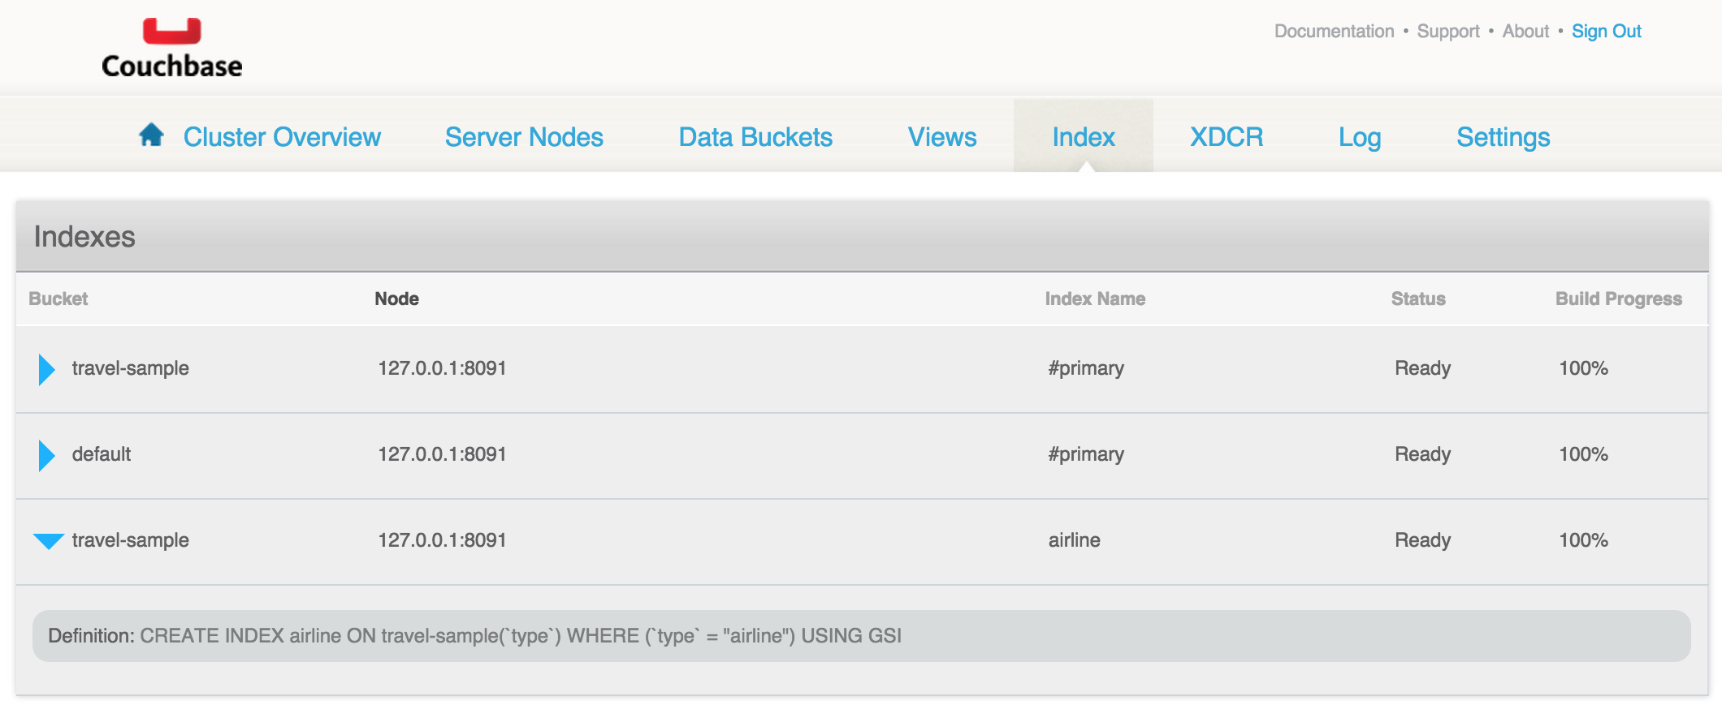

Slide 85
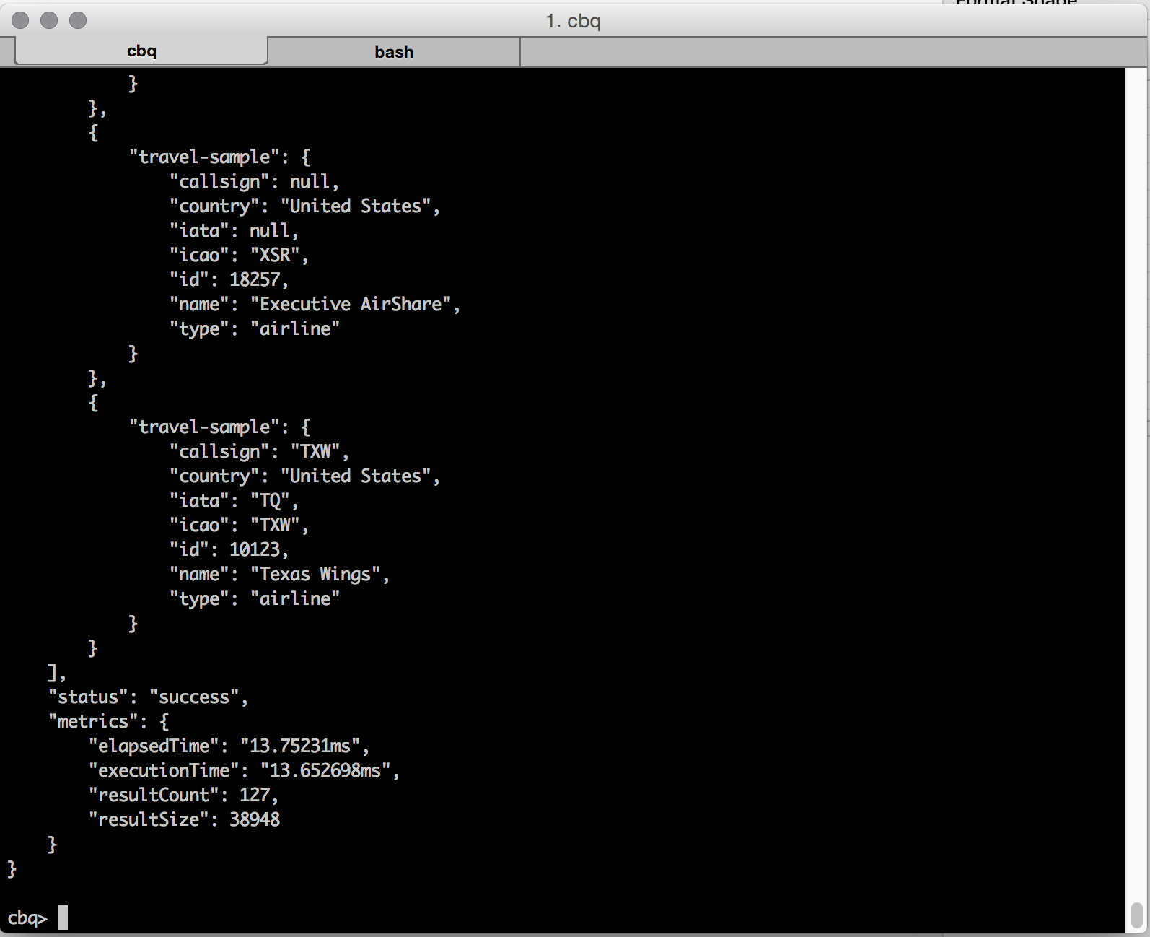
SELECT WITH AN INDEX
Notes:
We run the query again with that index and it takes 13 ms instead of 500.

Slide 86
JOINs

Slide 87
JOINs
Retrieve data from two documents in a single SELECT
Join within a keyspace/bucket
Join across keyspaces/buckets
Notes:
N1QL is all about giving you the data you want, not the data that happens to be in the database.
JOINs are an essential part of that.

Slide 88
IN JSON
{
"callsign": "UNITED",
"country": "United States",
"iata": "UA",
"icao": "UAL",
"id": 5209,
"name": "United Airlines",
"type": "airline"
}
{
"airportname": "Heathrow",
"city": "London",
"country": "United Kingdom",
"faa": "LHR",
"geo": {
"alt": 83,
"lat": 51.4775,
"lon": -0.461389
},
"icao": "EGLL",
"id": 507,
"type": "airport",
"tz": "Europe/London"
}
{
"airline": "UA",
"airlineid": "airline_5209",
"destinationairport": "SFO",
"equipment": "777",
"id": 57047,
"schedule": [
{
"day": 0,
"flight": "UA894",
"utc": "02:32:00" },
...
],
"sourceairport": "LHR",
"stops": 0,
"type": "route"
}
Notes:
Let's look at some sample docs from the travel sample.

Slide 89
A Simple Join
SELECT *
FROM `travel-sample` r
JOIN `travel-sample` a
ON KEYS r.airlineid
WHERE r.sourceairport="LHR"
AND r.destinationairport = "SFO";
Notes:
Using the travel sample data we can find flights from LHR to SFO. Explain that we're aliasing travel-sample twice, because both sides of the join are in the same bucket.
It's important not to conflate buckets and tables.
Run this in cbq as it's too much for a GIF.

Slide 90
Who Flies LHR->SFO?
SELECT DISTINCT a.name
FROM `travel-sample` r
JOIN `travel-sample` a
ON KEYS r.airlineid
WHERE r.sourceairport="LHR"
AND r.destinationairport = "SFO";
Notes:
Just as before, we’re getting a lot of repetition so let's get DISTINCT airline names back.

Slide 91
Unnesting The Schedule Data
SELECT a.name, s.flight, s.utc, r.sourceairport,
r.destinationairport, r.equipment
FROM `travel-sample` r
UNNEST r.schedule s
JOIN `travel-sample` a
ON KEYS r.airlineid
WHERE r.sourceairport="LHR"
AND r.destinationairport = "SFO"
AND s.day=1
ORDER BY s.utc;
Notes:
Here we use UNNEST and an inner join to find a list of all the flights from heathrow to SFO ordered by time. We are now aliasing the UNNESTed data too so we can easily use its data in our results.

Slide 92
N1QL Tutorial
http://query.pub.couchbase.com/tutorial

Slide 93
What We’ve Covered
Existing NoSQL Databases
Modeling Document Data
Designing Document Keys
Couchbase Document Querying
N1QL

Slide 94
Demo Time!
A Java SDK Example

Slide 95
Couchbase Labs on GitHub
Node.js
https://github.com/couchbaselabs/try-cb-nodejs
Java
https://github.com/couchbaselabs/try-cb-java

Slide 96
Questions?

Slide 97
Couchbase
We’re Hiring!

Slide 98
Thank You!
Nic Raboy
@nraboy (Twitter)

